Slide 1


Key Learning Points

Slide 2
Polypharmacy
Inappropriate versus appropriate prescribing is a useful approach
Adverse Drug Reactions and Drug-Drug Interactions are a common cause of ED attendance
Medicines reconciliation in the ED is important but BEWARE incomplete information
Ageing physiology affects drug metabolism, distribution, bioavailability and clearance
Start low, go slow
Medication rationalisation should be a patient-centred
Notes:
Inappropriate versus appropriate prescribing is more useful than a numbers based definition of polypharmacy
Adverse Drug Reactions and Drug-Drug Interactions are a common cause of ED attendance and admission in older people
Medicines reconciliation in the ED is important but remember you are likely to be working with incomplete information
Ageing physiology affects drug metabolism, distribution, bioavailability and clearance
Start low, go slow is a good approach for prescribing ANYTHING in a frail older person.
Medication rationalisation should be a patient centred discussion and tools exist to help with this.

Slide 3
Pain
50% of those aged over 65 years have pain
Assessing pain can be difficult (use tools e.g PAINAD, abbey pain scale)
Most patients will present with nociceptive pain
Detecting neuropathic pain is essential as management differs
Attempt none pharmacological treatments first
Try to avoid opioids
Topical analgesics have lower systemic adverse effects
If discharging with opiates give bowel protection
Notes:
50% > 65 have pain, 45-83% of patients in care have at least one painful problem
Assessing pain can be difficult, especially in patients with a cognitive or communication impairment (pain body map, numeric rating scale, pain thermometer, abbey pain scale)
Most patients will present with nociceptive pain secondary to osteoarthritis, soft tissue pain and visceral pathology
Detecting neuropathic pain is essential as management differs
Attempt none pharmacological treatments first (physio, acupuncture, CBT)
Try to avoid opioids and opiates, start low and go slow (dose reduced by 25% in 60 year old, 50% 80 year old)
Topical analgesics have lower systemic adverse effects
Regular pain assessments are key
If discharging with opiates give bowel protection

Slide 4
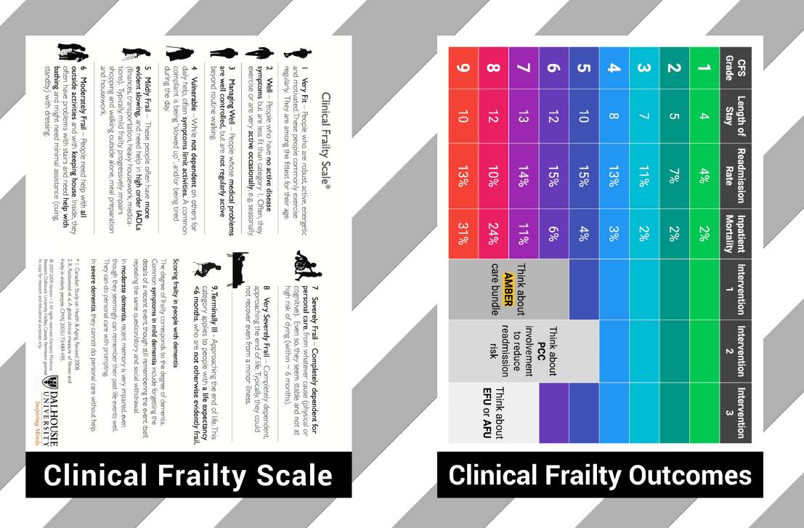
End of life care
Recognition of limited life expectancy (last 1000 days?)
Recognition of dying
Patient-centred
Consider patients preferred place of death in decision making
Palliative care involvement

Slide 5
Trauma
Low impact falls in older adults can result in serious injury
Primary survey is to identify immediate life-threatening problems and intervene
Use a rational approach to CT acquisition
Secondary survey should include a systematic search for injuries and for illness that may have precipitated event.
SILVER SURVEY - consolidate the findings of the primary and secondary surveys & risk factors for delirium
Notes:
It is important that triage teams are aware that same level falls in elderly patients are COMMON and CAN RESULT IN SERIOUS INJURY
The role of the primary survey is to identify immediate life-threatening problems and intervene accordingly. This is one aspect of care that should remain INJURY FOCUSSED, but requires tailoring to the elderly demographic.
It is important to take a rational approach to CT acquisition and NOT utilise a blanket approach of scanning every individual who presents with traumatic injuries.
Following the primary survey and associated imaging, a top-to-toe assessment should be performed to identify ADDITIONAL INJURIES AND ILLNESS that could have precipitated the traumatic event.
The purpose of the SILVER SURVEY is to consolidate the findings of the primary and secondary surveys as well as identifying any individual risk factors for the development of delirium.
During the Silver Survey, it is important for the lead clinician to be able to STEP BACK from the acute aspects of trauma care that can feel rushed or pressured, and adopt an individualised focus towards the patient.

Slide 6
Delirium
Delirium is frequently missed in the ED
Test for delirium and cognitive impairment using 6-CIT / 4AT
Look for predisposing and precipitating factors of delirium
Start non-pharmacological treatment as soon as possible, preferably in the ED
Start measures to prevent delirium in older patients with cognitive impairment

Slide 7
Syncope
Was the event TLOC? Was the origin syncopal?
Evaluate patients with unexplained falls with an assumption of unexplained syncope.
Is there a clear aetiological diagnosis?
Orthostatic hypotension has high prevalence among syncopal fallers,and reducing or withdrawing antihypertensives is likely to be beneficial.
Is there evidence to suggest a high risk of cardiovascular events or death?
Familiarity with low- and high- risk features can help to guide admission and investigation decisions.

Slide 8
Sepsis
Beware
-Atypical patient presentations (i.e. falls, syncope)
-Normal vital signs are not normal
-Most used scores do not work in older patient
-Undertriage
-You are scared to administer fluids
Missing
Undertreating

Slide 9
Abdominal pain
Common complaint and diagnostic challenge
Consider vascular emergencies early e.g AAA, mesenteric ischemia
Biliary tract diseases, bowel obstruction and peptic ulcer diseases more common than acute appendicitis, pancreatitis or diverticulitis
Don’t forget extra-abdominal causes e.g. myocardial infarction!

Slide 10
Evaluation

Slide 11
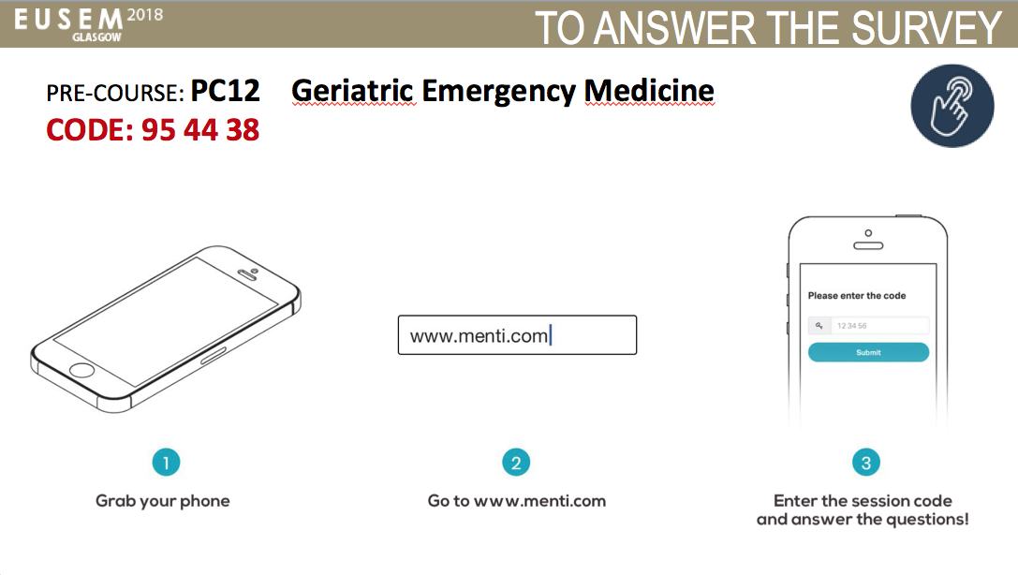
Complete Evaluation to get certificate!

Slide 12
Closing remarks

