Slide 1
End of life care for frail older people
EUSEM GEM Precourse 2023

Slide 2
Ethel
84 yo lady
P/C:
Increasing breathlessness for a week. Completed antibiotics Rx by her GP
She is noted to appear breathless and just not her usual self.
  more drowsy
  requiring more help than usual, for example with eating and drinking
PMHx & SHx
Advanced dementia
LTC in nursing home, requiring help with all activities of daily living. Usually eats independently.

Slide 3
Ethel
84 yo lady
The nursing home staff are worried as she did not improve despite oral antibiotics. They call the GP surgery at 4pm, and are advised to send Ethel to ED for assessment.
The ambulance crew arrive at 5pm, and find Ethel drowsy and not communicating.
  pulse 104, BP 90/50
  SaO2 87%, RR 28,
Tx: Oxygen, IV fluids and she was conveyed to hospital.
In ED, Dx: sepsis. Tx: IV Meropenem, IV fluids. Ix: showed..
GCS 13
chest clear, abdomen soft.

Slide 4
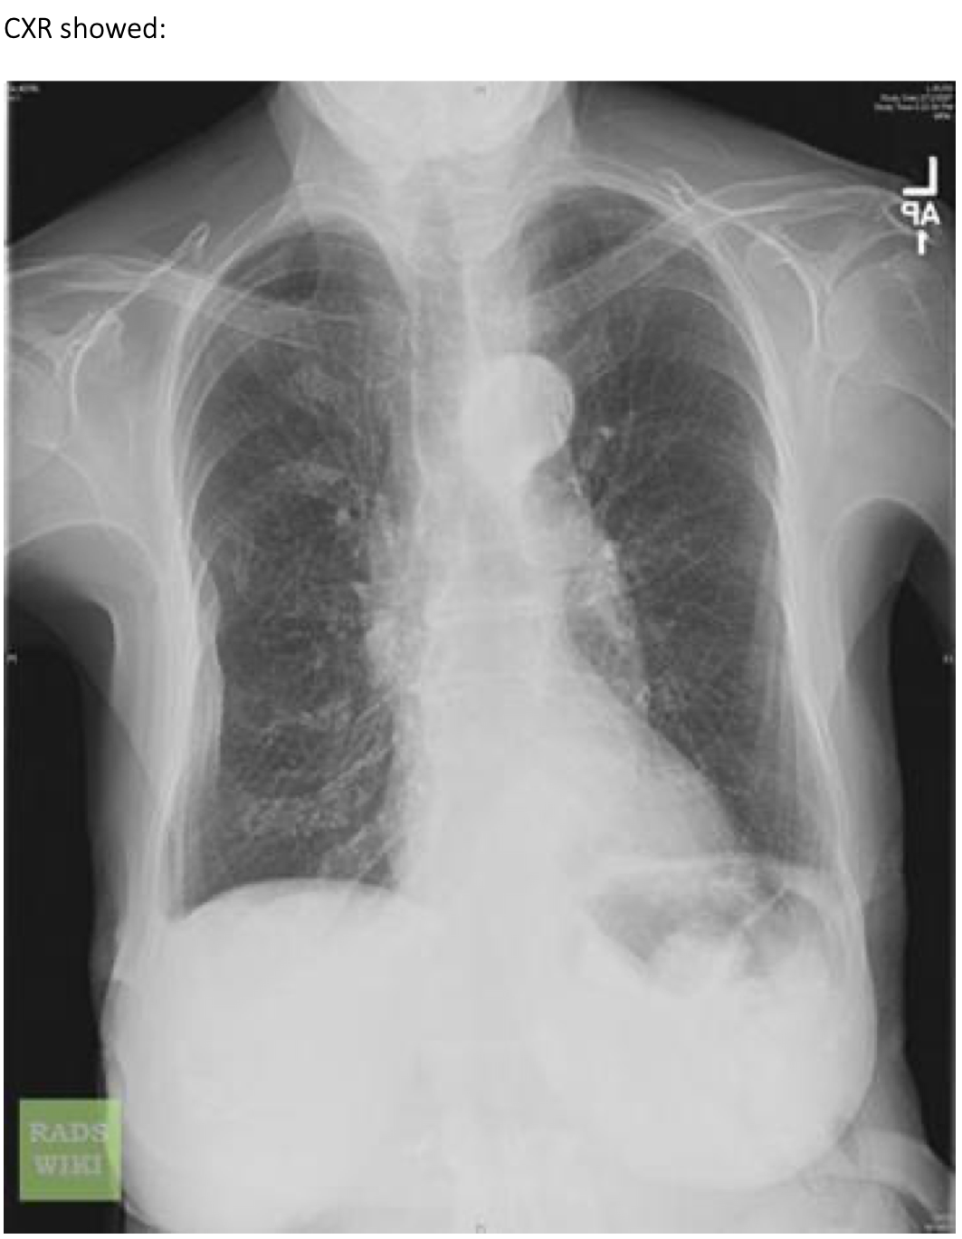
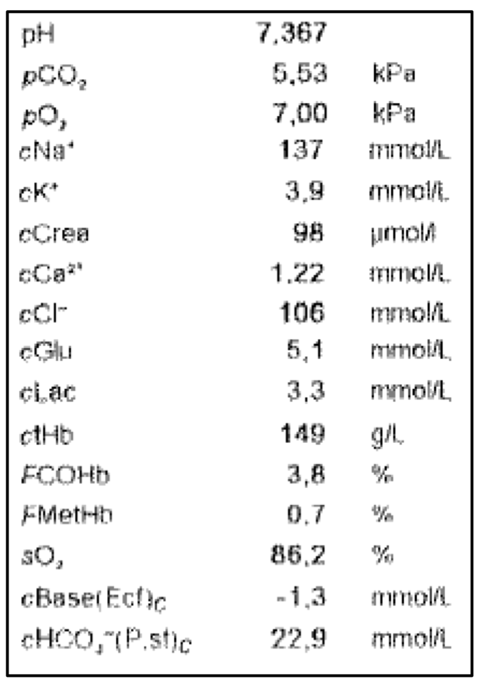

Slide 5
Ethel
84 yo lady
She was referred to the Acute Frailty unit, where she arrived at 01:00
  pulse 100, BP (improved) 110/60
  SaO2 94%, keeping 28% O₂ mask on.
The doctor called the nursing home, but the nurse did not know Ethel very well. She advised the doctor to read her care plan.
The care plan described Ethel’s deterioration over recent months, to a point where she was:
fully dependant, bed-bound, doubly incontinence
still usually able to eat with prompting
unable to make any high level choices
There was a DNACPR order in place
Her daughter was mentioned as next of kin
There was little additional info about her wishes and preferences
remains drowsy GCS 13
difficult to obtain info.

Slide 6
Ethel
84 yo lady
At 08:30, on the consultant ward round, Ethel was little changed – stable
Ix: Her bloods showed little extra information
WCC 11.4
CRP 24
Tx: Antibiotics were continued
She was transferred to a base ward. Ethel died in hospital a few days later.
Her daughter was with her when she died.
Ethel was comfortable, well cared for, pain free.
Her daughter expressed her thanks to the team for the care provided.
A post mortem was not undertaken and the death certificate was issued as: 1a Community acquired pneumonia, 2 dementia.

Slide 7
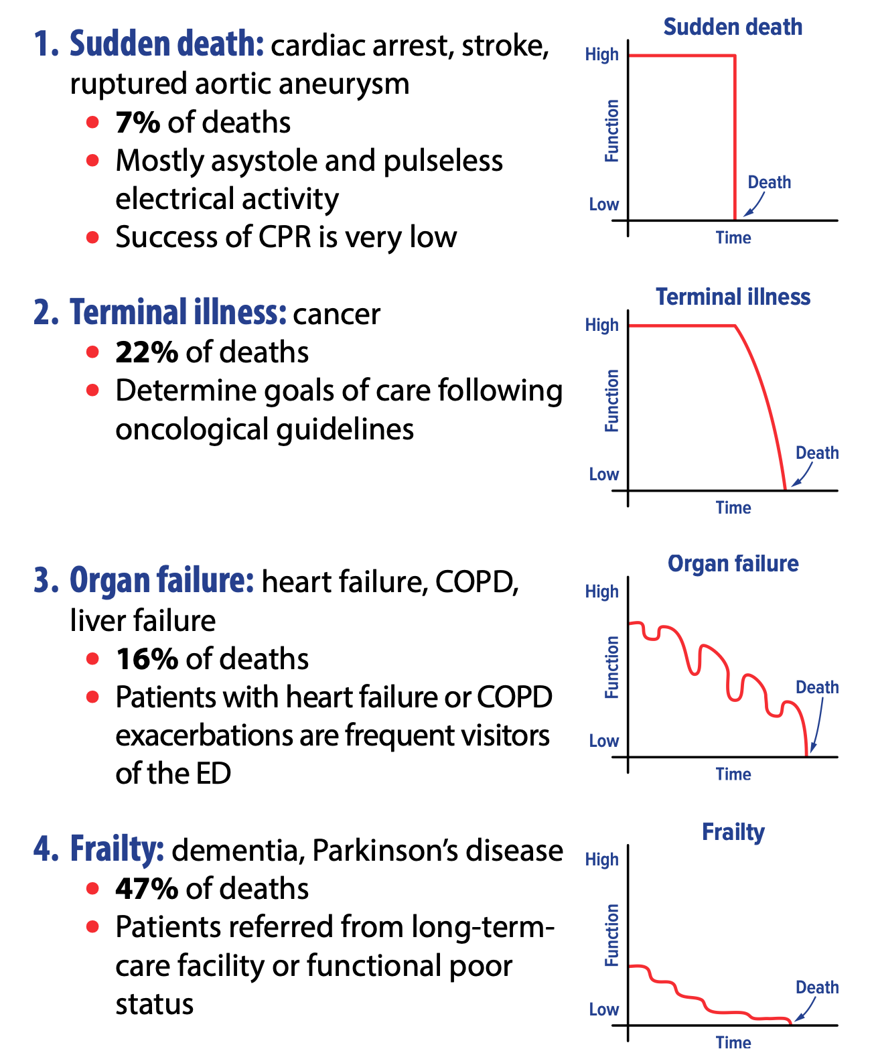

Slide 8
Questions
Was this a good end of life experience for Ethel?
What could have been done differently in the nursing home, by the ambulance crew, in the ED or in the frailty unit?
Do you agree with the death certificate?
How much of this was predictable?

Slide 9

Resources
http://posters.geriemeurope.eu/posters/p08/
https://eusem.org/wp-content/uploads/2017/10/EuSEM-Recommendations-End-of-life-care-in-EDs-September2017.pdf
https://www.bgs.org.uk/resources/end-of-life-care-in-frailty-urgent-care-needs
https://iaem.ie/wp-content/uploads/2020/09/IAEM-CLINICAL-GUIDELINE-EOL.pdf
https://www.marymount.ie/support-hub-for-healthcare-professionals/end-of-life-covid-19-resources/

