Slide 1
Polypharmacy table top discussion

Slide 2
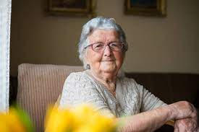
Mrs Smith
Age 85
Presenting complaint: Attends with daughter: Confused and drowsy for 28 hours with reduced oral intake

Slide 3
PMH
Cardiac failure
Atrial fibrillation
CKD stage 3
Stroke
Rheumatoid Arthritis
Hypertension
Duodenal ulcer

Slide 4
With Mrs Smith’s known medical history, which list of drugs is more concerning?
List A:
Edoxaban
Celecoxib
Prednisolone
List B
Edoxaban
Bisoprolol
Ramipril
Sulfasalazine
Digoxin
Furosemide
Paracetamol
Buprenorphine patch

Slide 5
Learning point:
‘Inappropriate’ versus ‘appropriate’ is a more useful classification than number- based definition of polypharmacy

Slide 6
Further information becomes available:
The cardiac nurse specialist saw Mrs Smith 5 days ago and doubled her dose of furosemide. Her GP recently increased her dose of digoxin 1 week ago on the advice of a discharge summary from the local hospital (which was 7 weeks late in arriving)
Bloods available:
Urea 24
Creatinine 350 (baseline 180)
Sodium: 130
Potassium: 1.9
Digoxin level: 6.5
What has happened?

Slide 7
Drug Drug Interaction (DDI) and Adverse Drug Reaction (ADR) are a common cause of attendance and admission
Medicines reconciliation in the ED is important…
but remember you are likely to be working with incomplete information

Slide 8
She becomes very agitated and is given diazepam.
What sort of dose should she get? Why?

Slide 9
‘Start low, go slow’ is a good approach for prescribing ANYTHING in an older person with frailty.

Slide 10
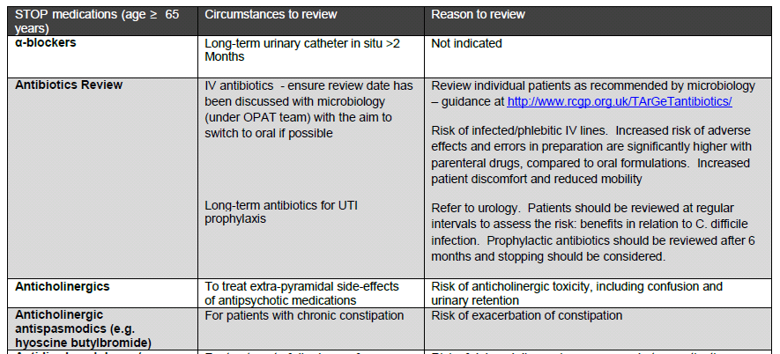
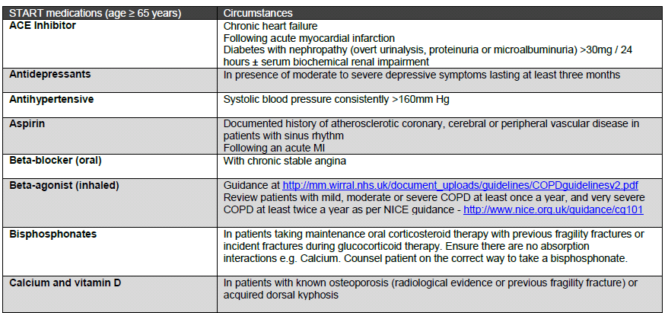
What to STOPP and what to START
STOPP START criteria
http://www.polypharmacy.scot.nhs.uk/about/

Slide 11
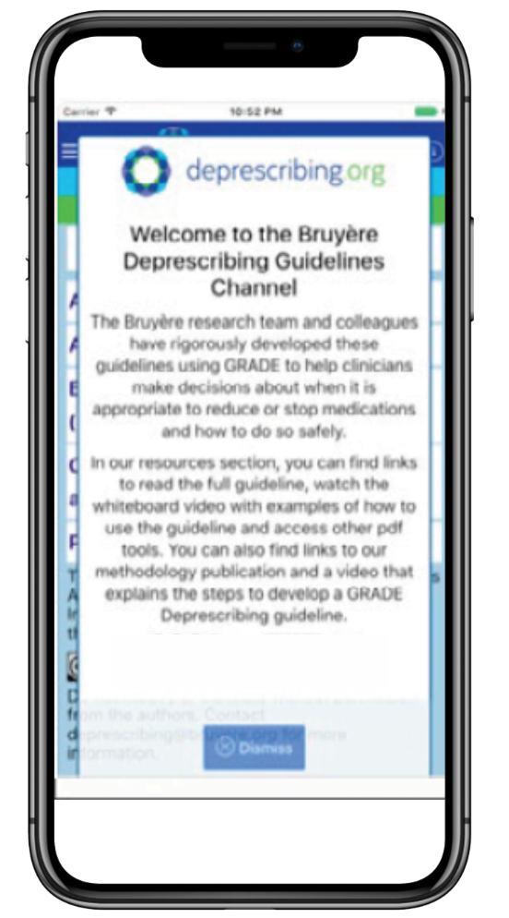
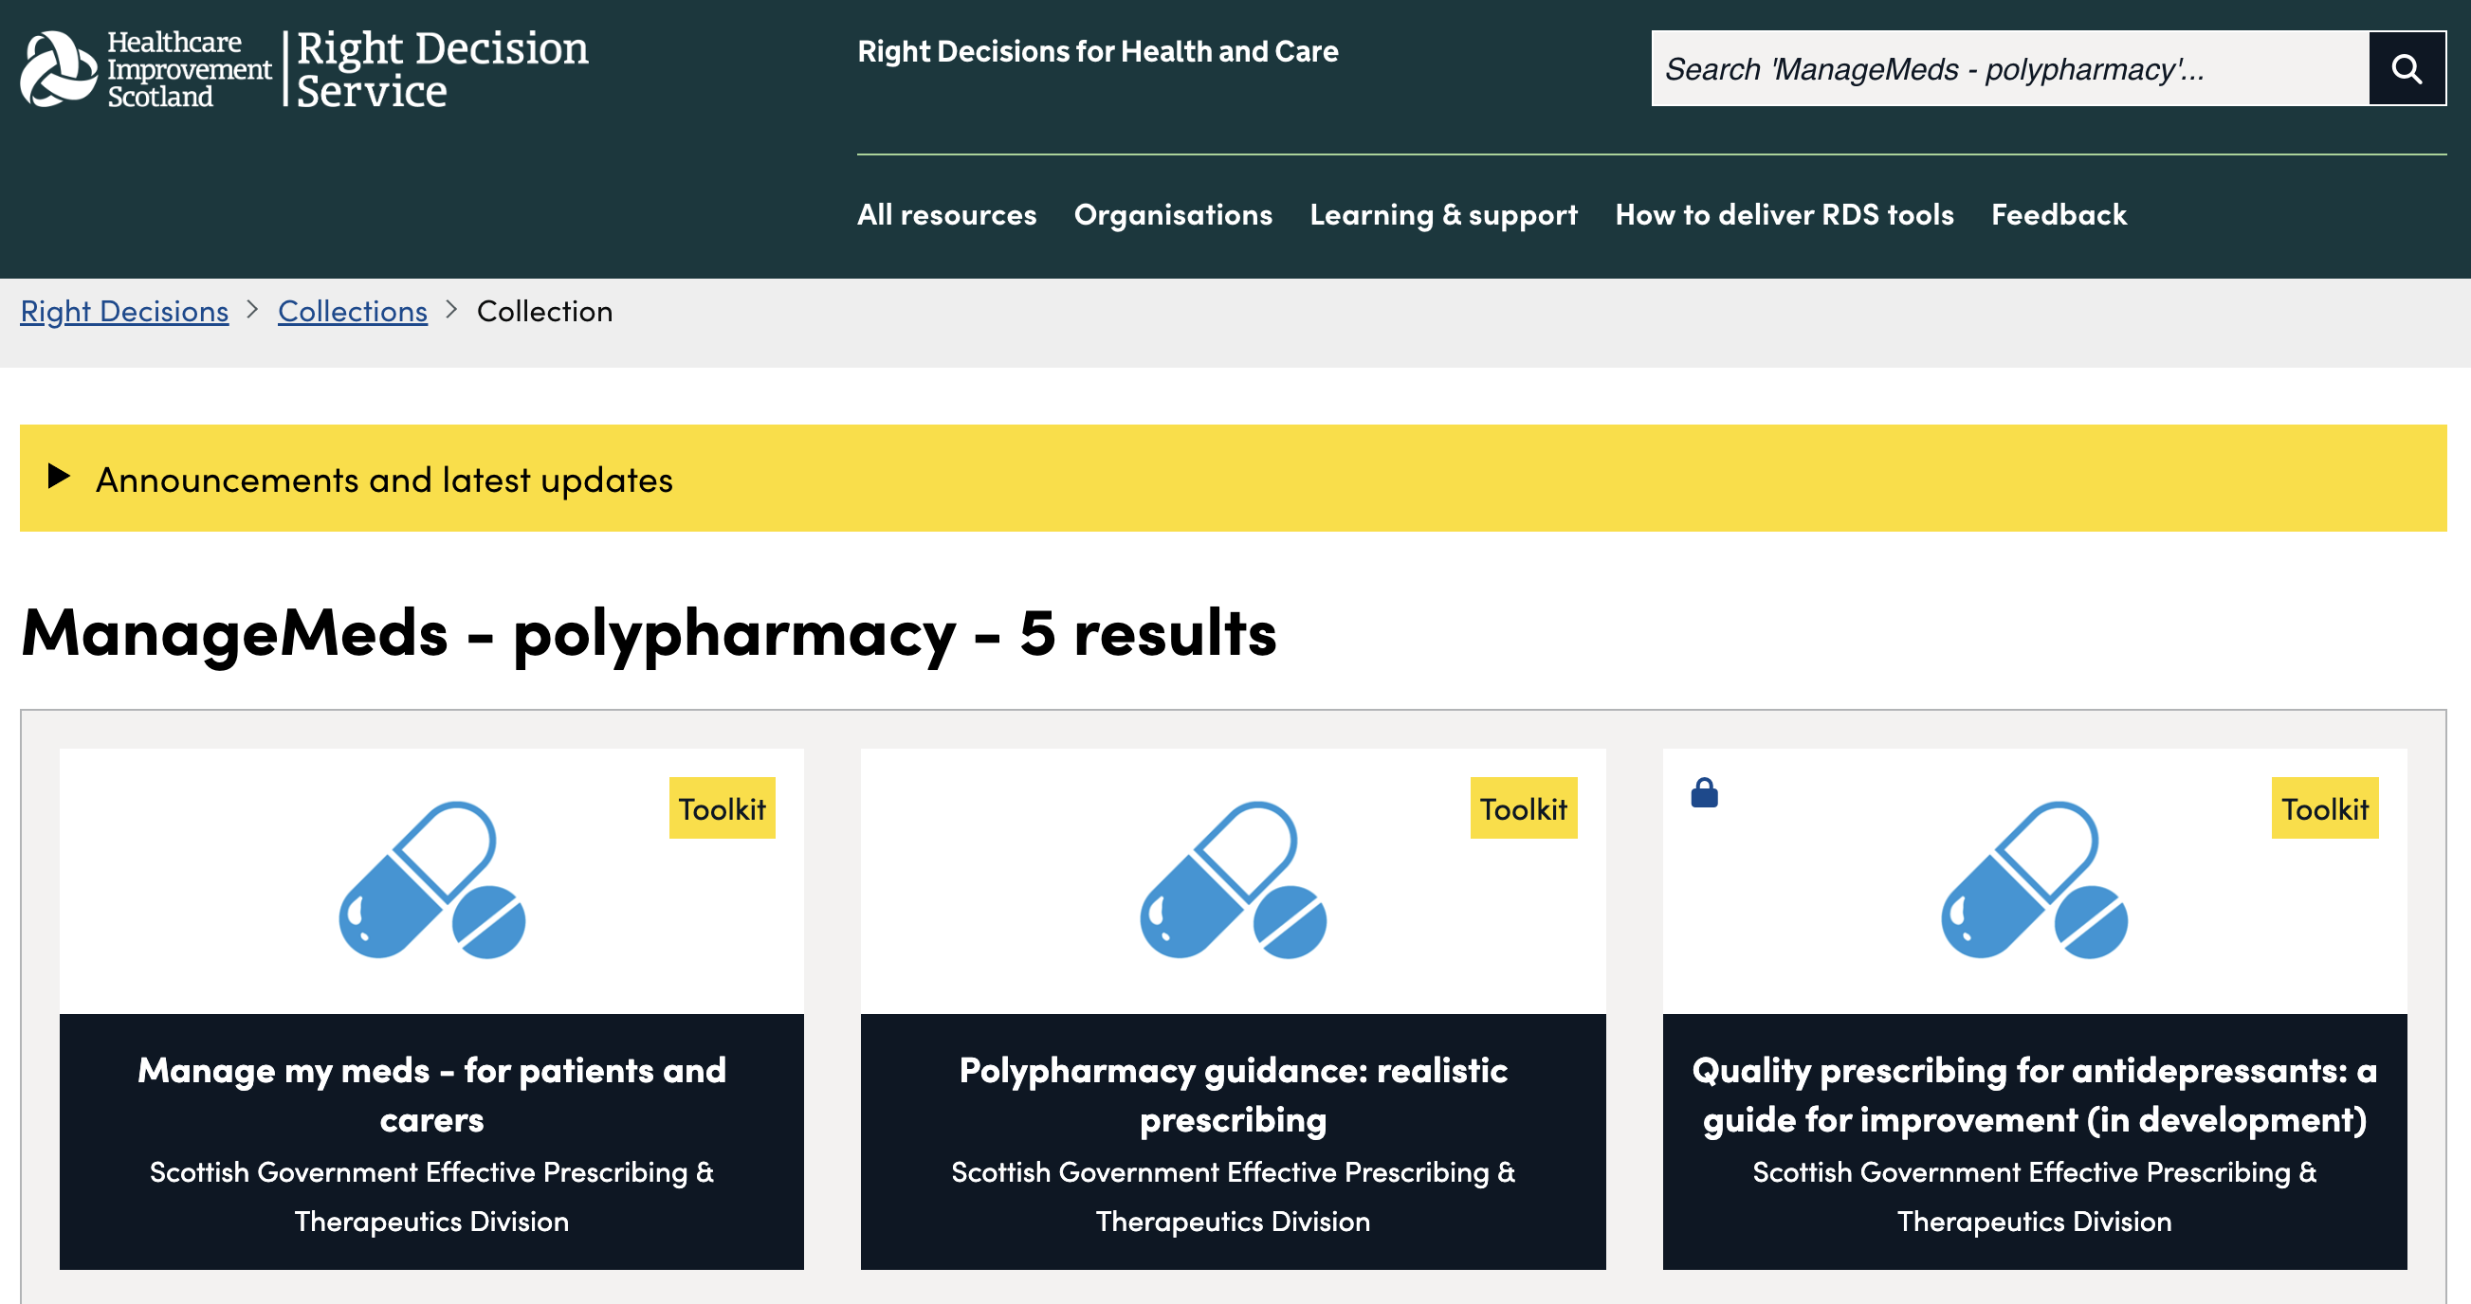
NHS Scotland: ManageMeds
Deprescribing.org

Slide 12
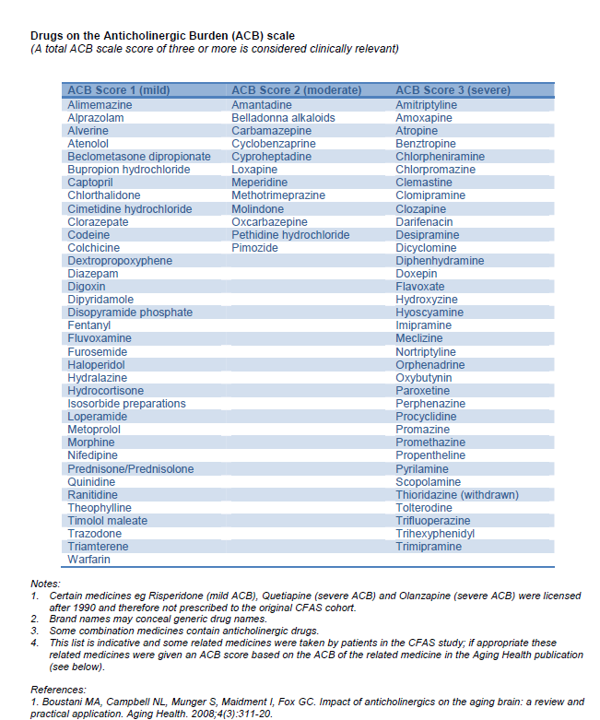
Anticholinergic Burden Scale
A total ACB score of 3 or more is clinically significant
http://www.acbcalc.com/

Slide 13
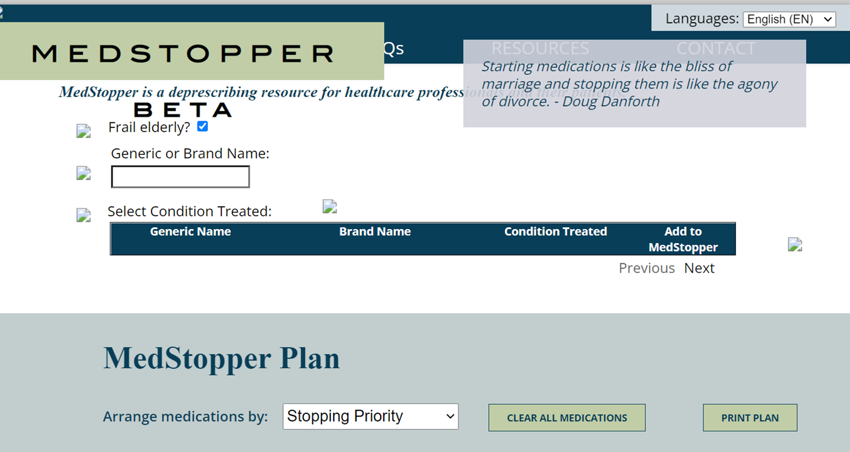

Slide 14


Polypharmacy
Inappropriate versus appropriate prescribing is a useful approach
Adverse Drug Reactions and Drug-Drug Interactions are a common cause of ED attendance
Medicines reconciliation in the ED is important but BEWARE incomplete information
Ageing physiology affects drug metabolism, distribution, bioavailability and clearance
Start low, go slow
Medication rationalisation should be a patient-centred
Notes:
Inappropriate versus appropriate prescribing is more useful than a numbers based definition of polypharmacy
Adverse Drug Reactions and Drug-Drug Interactions are a common cause of ED attendance and admission in older people
Medicines reconciliation in the ED is important but remember you are likely to be working with incomplete information
Ageing physiology affects drug metabolism, distribution, bioavailability and clearance
Start low, go slow is a good approach for prescribing ANYTHING in a frail older person.
Medication rationalisation should be a patient centred discussion and tools exist to help with this.

Slide 15
Useful Resources
http://www.acbcalc.com/
https://deprescribing.org

