Slide 1
Syncope in older people

Slide 2
Describe and classify syncope
Recognise the limitations of guidelines applied to older people living with frailty
Integrate evidence and person-centred assessment during shared decision-making

Slide 3
Syncope:
  transient loss of consciousness
    amnesia / loss of awareness, abnormal motor control, unresponsiveness
  due to cerebral hypoperfusion
Characteristically:
  rapid onset
  short duration
  complete recovery
2018 ESC syncope guidelines

Slide 4
Syncope
Classification
Reflex
(neurogenic, ‘vasovagal’)
Cardiogenic
Orthostatic
hypotension
Caution! head trauma, epileptic seizure, psychogenic seizures can also cause transient loss of consciousness

Slide 5
“there is strong consensus that the management of unexplained falls in older people should be the same as that for unexplained syncope”
2018 ESC syncope guidelines

Slide 6
Risk assessment
Many scores exist, but these are not validated for older people living with frailty. Clinician judgement necessary!
Low risk:
Prodrome symptoms
Likely trigger
Recurrent identical events
Normal examination
Normal ECG
High risk:
Chest pain / palpitations
During exertion
While lying / sitting
Structural / coronary artery disease
Certain ECG abnormalities
Most older people are somewhere in between!

Slide 7
Ambulance case record
Situation
88 year old person, fall
Assessment
Person cannot now recall events. Had telephoned their daughter and said they were reaching for a kitchen cupboard, felt dizzy, and fell backwards. Unable to get up.
On arrival: sitting against wall. Bruised left shoulder. Comfortable. No other injuries.
Felt unsteady when helped to stand up
Recommendation
Transferred to ED for assessment
Background
Hypertension, mild dementia
Apixaban, bisoprolol, amlodipine, furosemide
Lives alone. Carer visits twice daily

Slide 8
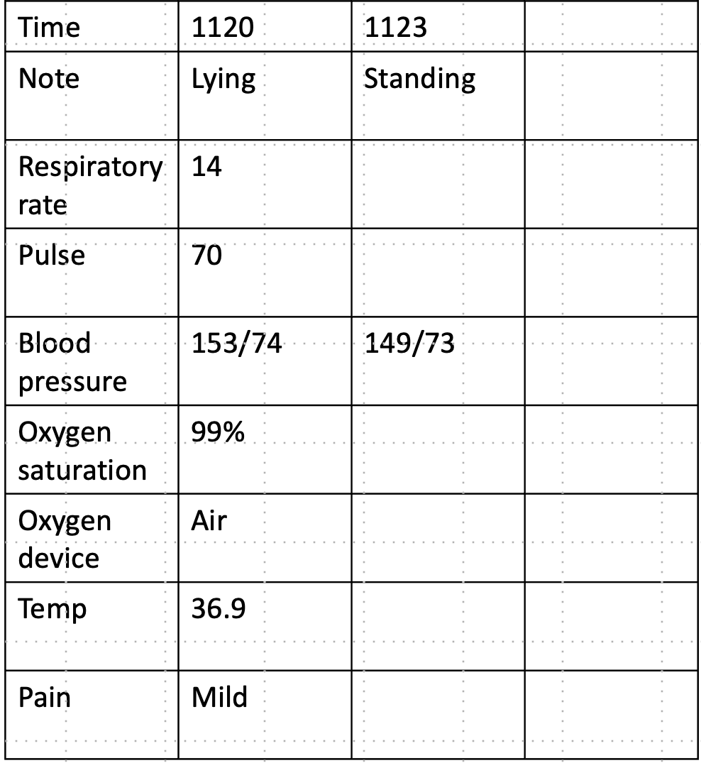

Slide 9
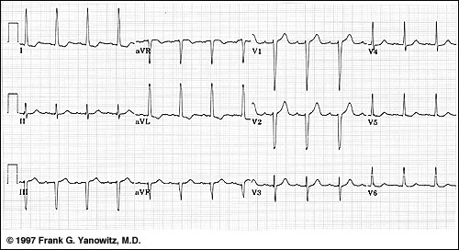

Slide 10
Was this syncope? What is the danger of this happening again?
What does the person want?
What investigations or interventions are required?
Can she go home?

