Slide 1
Delirium table top discussion
Notes:
Cognitive problems including Delirium and Dementia are common in Older Adults presenting to the Emergency Department (ED). Up to 20% of older adults using the ED have some degree of pre-existing cognitive impairment.¹ Delirium affects about 10% of older patients in the ED.² Prolonged stays in the ED are associated with development of delirium in vulnerable people.³
Delirium is associated with a threefold increased mortality rate. It is also associated with accelerated functional decline, accelerated cognitive decline and longer stays in hospital.^{4,5}
It has been shown that over 50% of delirium is missed in the ED and that missed delirium is associated with a three-fold increase in mortality at 3 months.⁶

Slide 2

Mrs Robinson
Age 86
Attends with son
Presenting complaint:
  Ambulance transfer after fall
    Not cooperative
    Normal vital signs
    Slightly elevated temperature
    Some crepitus

Slide 3
Medical history
Medication use
Hearing problems
Hypertension
Hypercholesterolemia
Atrial fibrillation
Sleeping problems
Elanapril
Metoprolol
Simvastatin
Nortrilen (antidepressant)
Lorazepam

Slide 4
Heteroanamnesis
PREMORBID situation
Lives alone, one son.
Could manage with help of her son and daily delivery of a meal service.
CURRENT situation
In the afternoon the son found his mom in her pajamas, while she usually is always dressed perfectly.
She did not understand why he visited her and what day it was. She kept asking about her departed husband.
Because he was worried he stayed the night, but during the night she was constantly walking around the house. She also was seeing crows flying around the room.
This morning she was also a bit groggy and fell in the living room, after which he decided to call an ambulance.

Slide 5
Does this patient have delirium?
What symptoms do you recognize?
What type of delirium is this?

Slide 6
Do you use a screener in clinical practice to detect delirium in all ED patients?
    If yes, which one?
    At what moment of ED arrival do you screen for delirium?
What diagnostics would you like to do?

Slide 7
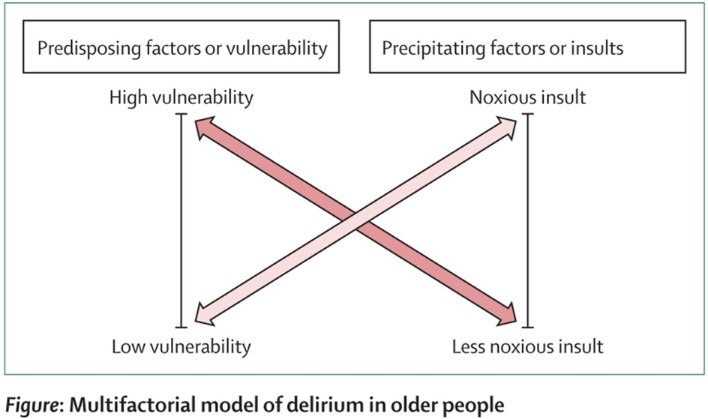
What predisposing and precipitating factors does this patient have?

Slide 8
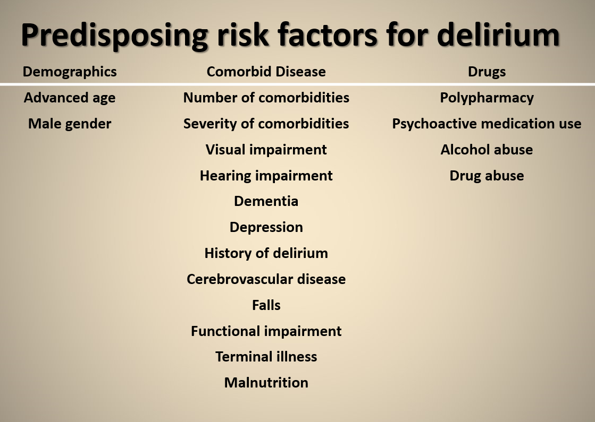

Slide 9
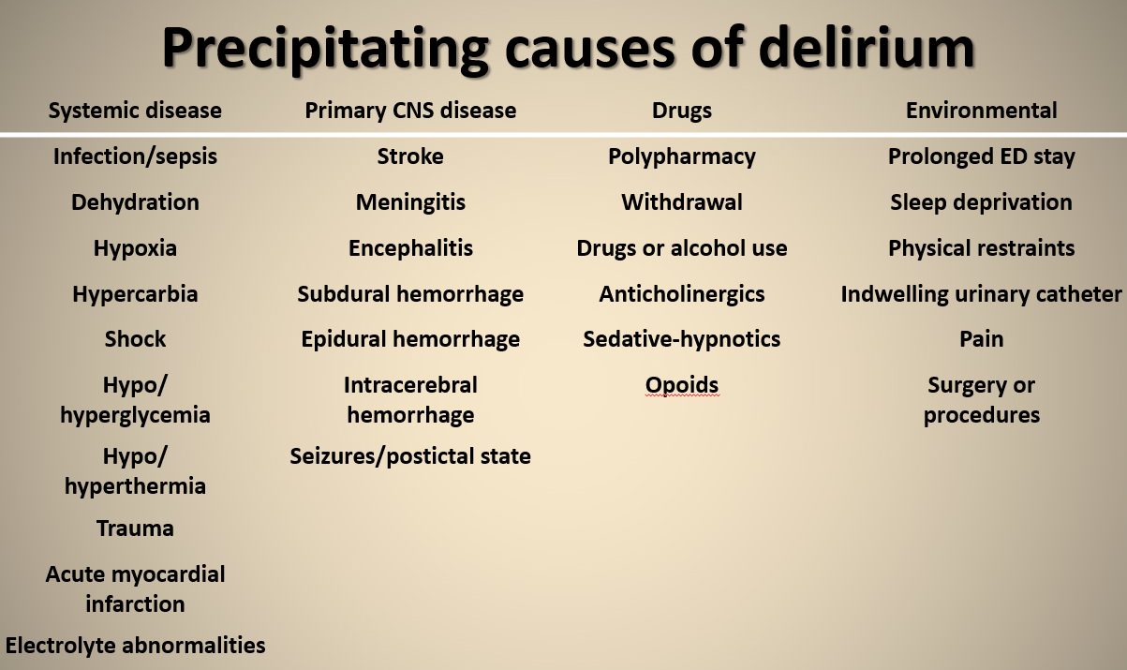

Slide 10
What pharmacological treatment would you consider?
What non-pharmacological treatment would you consider in the ED and during admission?

Slide 11
What model of care do you have in the ED?
  Do you test for cognitive impairment in the ED?
  Do you start preventive measures in the ED?
  Do you use a multidisciplinary approach?
  Is a geriatrician involved?

Slide 12







Delirium
Delirium is frequently missed in the ED
Test for delirium and cognitive impairment using 6-CIT / 4AT
Look for predisposing and precipitating factors of delirium
Start non-pharmacological treatment as soon as possible, preferably in the ED
Start measures to prevent delirium in older patients with cognitive impairment

Slide 13
Useful Resources
https://posters.geriemeurope.eu/posters/p04/
https://www.the4at.com/
https://deliriumnetwork.org/about/delirium-research-resources/

