Slide 1
Pain in the older patient tabletop discussion
Notes:
Importance and comfort
Identify pain
Rate it
Approach and options

Slide 2

Edna Jones
Age: 79
Presenting complaint: lower back pain, nausea, abdominal distention

Slide 3
History
CKD2
Controlled hypertension
Previous stroke – expressive dysphasia
Osteoarthritis - knees
Fibromyalgia
Medication:
Aspirin
Bisoprolol
Amlodipine
Simvastatin
Citalopram
Co-codamol 8/500mg
Ferrous fumarate
Notes:
Co-codamol - paracetamol codeine

Slide 4
Social history:
Lives alone in a 3 bedroomed flat
Stairlift
Carers twice per day for washing and medication
Can walk 2-3 metres due to knee and lower back pain
weight 52 kg

Slide 5
How will you assess Mrs Jones’s pain?
Location, chronicity and severity?
Notes:
Normal pain assessment
Scales / Scores
1-10 NRS
Cognitive impairment
VAS - smiley faces

Slide 6
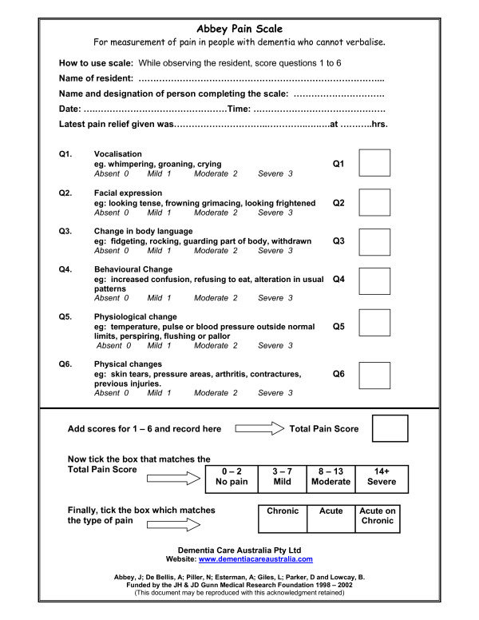
How will you assess Mrs Jones’s pain?
Location, chronicity and severity?
Notes:
PAINAD - developed in the USA - behavioural score. Useful for triage -
Abbey pain score - also behavioural score

Slide 7
What is worrying about Mrs Jones’ presentation, medication and social history?
Notes:
Cancer / AAA / medical concerns,…
Weight based dosing
Constipation
Delirium
Social setting: New carers

Slide 8
Mrs Jones has had unchanged bilateral knee pain and lower back ache for several years, following a fall three months ago she was started on oral co-codamol 8/500mg as required. Her carers changed last week, and her medicines chart show she has received 8 tablets per day.
What is worrying about Mrs Jones’ presentation, medication and social history?
Notes:
Weight based dosing - Paracetamol
Think about Weight based dosing - lots medications not licensed <50Kg

Slide 9
Mrs Jones’ examination is mostly normal, there is a soft fullness in the left iliac fossa, some hard stool in her rectum but her bloods are essentially normal apart from a slightly chronically raised urea and creatinine (7 and 70). And abdominal x-ray performed from triage shows an old wedge fracture of L3.
How will you manage Mrs Jones?
Notes:
“Observation unit” / Short stay unit
Pain control and functional assessment
Constipation - enema and oral laxatives
Topical NSAIDs - should be well tolerated in CKD, just need to be monitored
Bracing - difficult in low weight, what you are achieving (if mobilising without, not shown benefit to reduce pain)
Consider: NSAIDs; opiate sparing / margin ; neuropathic pain meds. Joint injection, knee replacement…

Slide 10
As you plan to discharge her with appropriate analgesia, her daughter mentions if she should still take the night time special pain killer for restless legs?
Notes:
What special nighttime medication
sleeping tablet - falls risk
amitriptyline
lots of people can be on atypical medications
If the pain is bad enough, they can have tried anything - Worth bearing in mind side effects

Slide 11
Side effects of atypical analgesics
TCAs = urinary retention, postural hypotension, cardiac arrhythmias. 1 in 5 stop due to adverse effects
SSRI/SNRI = minimal evidence base but duloxetine has shown efficacy for neuropathic pain, especially diabetic
Anti epileptics = older medication such as carbamazepine and phenytoin have central adverse events and require blood monitoring. Newer phenytoin and gabapentin have shown efficacy and fewer side effects.
Topical NSAIDs have been demonstrated in several studies as efficacious in non-neuropathic pain.
Notes:
SSRI - widely used, minimal evidence in neuropathic pain
topical NSAIDs - less systemic effects
reduce spasm

Slide 12
Mrs Jones asks about specialist follow up for her pain, and any interventions?
Notes:
We have the pain and constipation managed, temporarily we have a plan. Not all referrals need to happen from ED - consider from community…
Social prescription - keeping mobile.
Pain team
MDT - Physiotherapy, geriatric falls clinic, OT. GP. Acupuncture. CBT.
What do you have in your own countries?

Slide 13
Learning points
Various pain scores according to cognitive and communication abilities of the patient
Side effects of medication, weight-based toxicity, red flags for pain
Comparison of the various analgesics and safe use in ED
Atypical analgesics and specific conditions they can be used for
Referral to chronic pain teams, physio, mindfulness and occasionally CBT/acupuncture
Notes:
Buprenorphine - The patch check before considering opiates
Any other modes you would consider
Acute pain - block - ED / anaesthesia

Slide 14










Pain
50% of those aged over 65 years have pain
Assessing pain can be difficult (use tools e.g PAINAD, abbey pain scale)
Most patients will present with nociceptive pain
Detecting neuropathic pain is essential as management differs
Attempt none pharmacological treatments first
Try to avoid opioids
Topical analgesics have lower systemic adverse effects
If discharging with opiates give bowel protection
Notes:
50% > 65 have pain, 45-83% of patients in care have at least one painful problem
Assessing pain can be difficult, especially in patients with a cognitive or communication impairment (pain body map, numeric rating scale, pain thermometer, abbey pain scale)
Most patients will present with nociceptive pain secondary to osteoarthritis, soft tissue pain and visceral pathology
Detecting neuropathic pain is essential as management differs
Attempt non-pharmacological treatments first (physio, acupuncture, CBT)
Try to avoid opioids and opiates, start low and go slow (dose reduced by 25% in 60 year old, 50% 80 year old)
Topical analgesics have lower systemic adverse effects
Regular pain assessments are key
If discharging with opiates give bowel protection

