Slide 1


SEPSIS
Mrs Johnson
...and her daughter
Notes:
0-5 min: Set:
-Explanation of scenario.
-This is a patient I have seen myself.
-Try to be as realistic as possible.
-You have one non-obstructive nurse.
-Assessment: You hear what you here. If you have a question: Ask the patient>She can talk! If you want to know what you are seeiing ask what you whant to know.
-Assessment: If you want to have vital signs: Ask the instructor
-Treatment: If you want to admister O2, fluids, or medication ask the nurse. She will give what you want.
Roles:
-One participant needs to be the doctor
-One participant needs to be the nurse.
-Two participants need to observe and register the actions.
-One instructor is leading the scenario and provides information if asked.
Equipment:
-LOTUS patient who needs to be instructed before we start.
-Simmon APP (I have it on my iPhone). We need an iPAD to be used as monitor.
-Non-rebreathable mask.
-nasal cannula for oxygen administration.
-intravenous catheters and tape to fixate on patients.
-two times 500 ml of normal saline or ringers lactate.
-two observer registration forms per scenario.

Slide 2
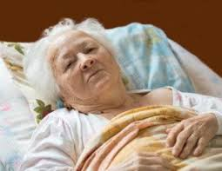
Meet Mrs Johnson…
An 80-year old woman who is brought in by her daughter
although her mother has no complaints.
Notes:
6-16 min:
Dialogue:
The scenario.
See special forms for details.

Slide 3
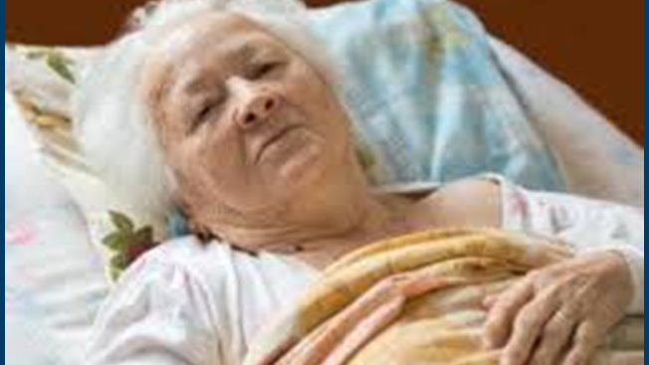
Medical information Mrs Johnson…
Past Medical History:
1998:COPD Gold 2,
2008: DM2,
2010: Anterior myocardial infarction
Medication:
Seretide
Metformin 1dd500 mg
Aspirin 1dd 100 mg
Perindopril 1dd2 mg
Nitroglycerin
Furosemide 1dd20 mg
Notes:
6-16 min:
Dialogue:
The scenario.
See special forms for details.
If asked:
Functional: Living independent. Normal ADL.
Social: Lives alone. Daughter lives nearby. Her son lives in USA
Cognition: Normal.

Slide 4
Vital signs at triage Mrs Johnson…
Triage (Manchester Triage System):
O₂ saturation: 97%
Heart rate: 75/min
Temperature: 37.7 ºC
MTS category: GREEN
Notes:
6-16 min:
Dialogue:
The scenario.
See special forms for details.

Slide 5
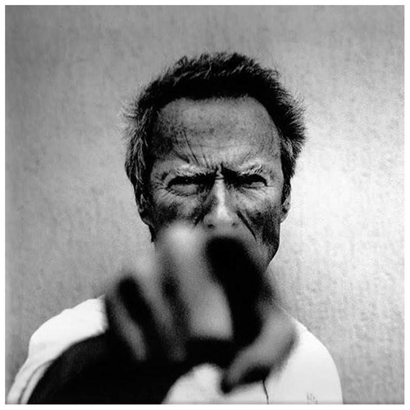
Now it’s your turn…
Notes:
6-16 min: Dialogue:
The scenario.
See special forms for details.

Slide 6

Unwell
Under
triage
=
Notes:
17-23 min: Discussion:
Slides 6 to 14 function as background and possible aids in the discussion.
It is not necessary to present them all.

Slide 7
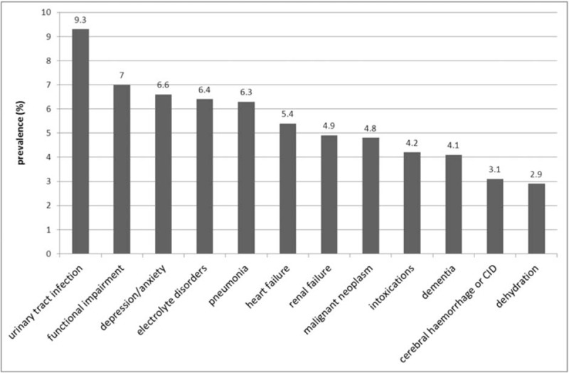
Non-specific complaints (Feeling unwell)
Notes:
Slides 6 to 14 function as background and possible aids in the discussion.
It is not necessary to present them all.

Slide 8
Risk stratification
Most risk straticiation scores (MEWS/qSOFA/PIRO) dont work in older patients

Slide 9
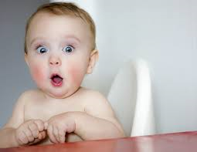

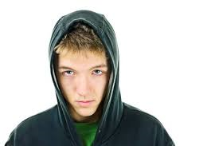
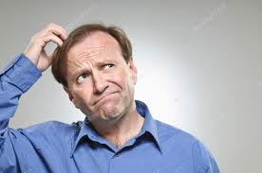
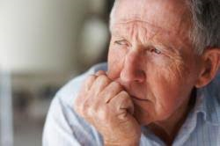
'Normal’ vital signs change with age
Syst BP:
70-90
80-95
100-120
120
140
Notes:
Slides 6 to 14 function as background and possible aids in the discussion.
It is not necessary to present them all.
2. QUESTION to aid in discussion: What is a normal systolic blood pressure for ED patients of 70 years or older?

Slide 10
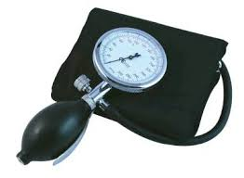
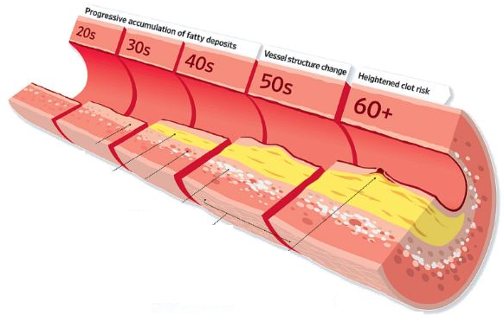
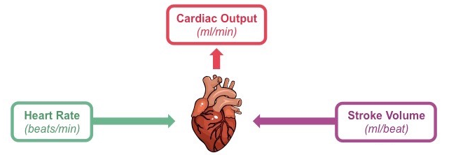
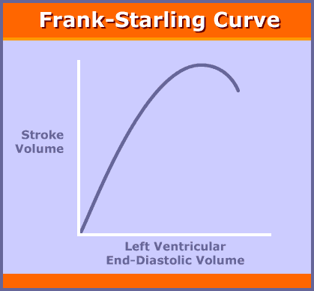
Changing (patho)physiology
Afterload
Contractiliteit
Preload
Notes:
Slides 6 to 14 function as background and possible aids in the discussion.
It is not necessary to present them all.
4. QUESTION to aid in discussion: Is it bad medicine to administer fluids to ED patients of 70 years or older with chronic heart failure?

Slide 11
Take home messages Sepsis in 70+
1. You will miss it because:
-Atypical patient presentations (i.e. falls, syncope…)
-Normal vital signs are not normal
-Most used scores do not work in older patient
2. You will undertreat it because:
-Undertriage
-You are scared to administer fluids
Notes:
24-25 min: Closure:
-Summarize key messages on slide and then quit.

