Slide 1


Geriatric Emergency Medicine

Slide 2
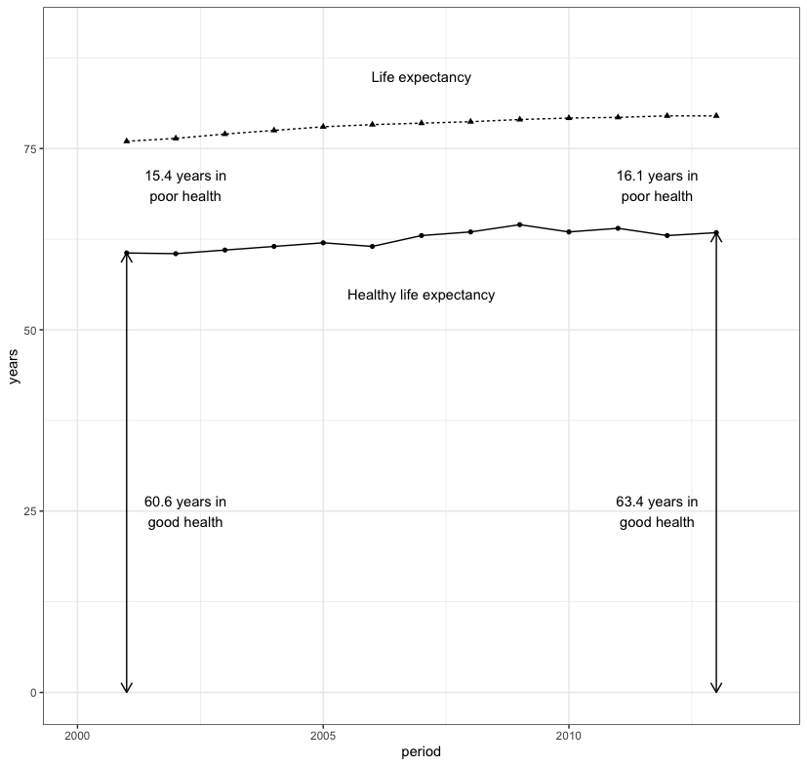
Why GEM?
Demography
Absence of immortality
Limitations of admission avoidance
Reality

Slide 3
Frailty
Distinctive health state associated with later life
Apparently minor events are associated with adverse health outcomes
Independent predictor for:
Falls
Delirium
Disability
Hospitalisation
Care home admission

Slide 4
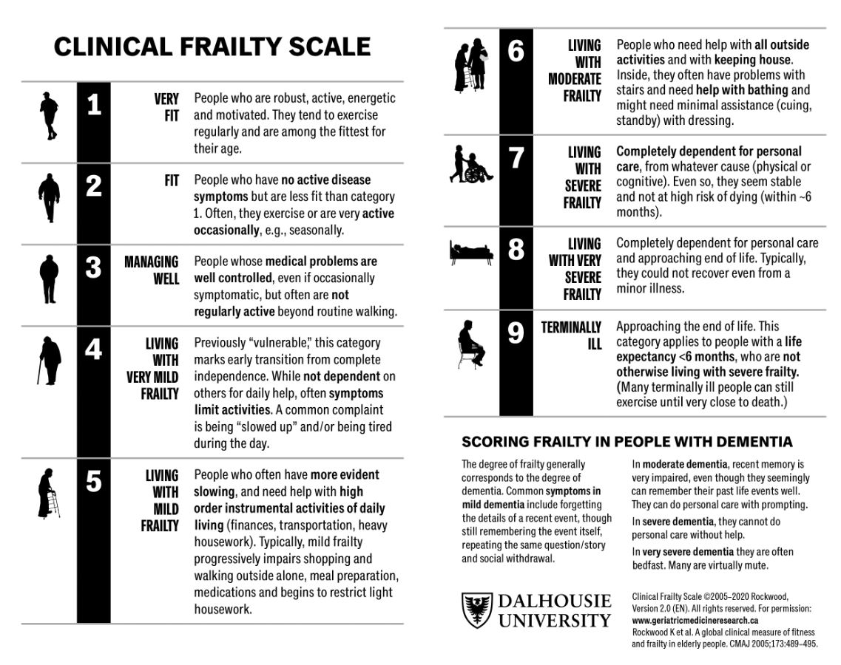

Slide 5
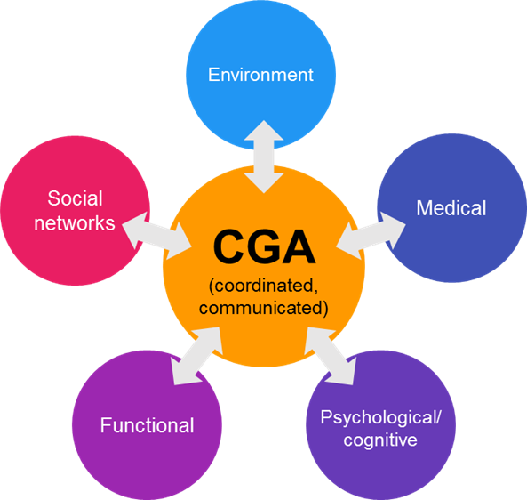
Comprehensive Geriatric Assessment
“A multidimensional, interdisciplinary diagnostic process to determine the medical, psychological, and functional capabilities of a frail older person in order to develop a coordinated and integrated plan for treatment and long-term follow-up.”

Slide 6
A bit of detail...
Multidimensional:
Not just troponin pathways for chest pain
Interdisciplinary diagnostic process:
Flattened hierarchy
Mutual respect
Constructive challenge
Coordinated and integrated plan for treatment:
Understanding of each other’s roles and expertise
Follow-up:
Sometimes bad things happen

Slide 7
A bit of detail...
Assessment
Goals
Stratified
problem list
Bespoke management plan
Prof A Gordon, University of Nottingham

Slide 8
Practical CGA in Urgent Care
Identify frailty
Broaden the assessment
Do something different:
  Prognosticate
  Person centred approach
  Shared decision making

Slide 9
GEM competencies
Geriatric medicine
Delirium vs dementia
Asymptomatic bacteriuria
Falls assessment
Medication reviews
Rehabilitation
Long term conditions
Palliation
  Emergency medicine
  Undifferentiated patients
  Trauma
  Resuscitation
  Situational awareness
  Rapid assessment
  Risk assessment

Slide 10
Summary
GEM is emerging as a subspecialty
CGA improves outcomes for older people with frailty and urgent care needs
Use CGA as an organising framework
Don’t neglect the underpinning competencies
Measure, iterate, and improve

