Slide 1


Introduction

Slide 2
Why Geriatric Emergency Medicine?
Changing demography due to improved social and medical conditions
“usual care” is not adequate
Goal is improved quality of care AND system function
Reality

Slide 3
What is Geriatric Emergency Medicine?
Improved geriatric-specific skills knowledge and attitudes of ALL emergency department staff
AND
Improved models of care that require system-level changes

Slide 4
Frailty
Distinctive health state associated with later life
Apparently minor events are associated with adverse health outcomes
Independent predictor for:
  Falls
  Delirium
  Disability
  Hospitalisation
  Care home admission

Slide 5
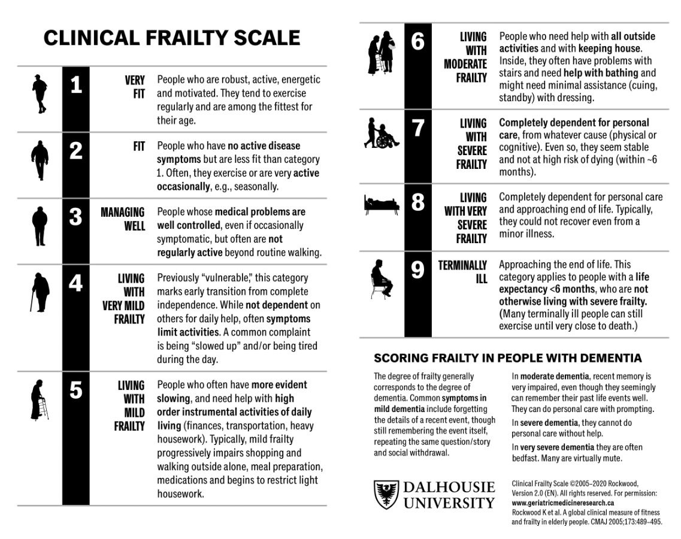
https://www.dal.ca/sites/gmr/our-tools/clinical-frailty-scale.html

Slide 6
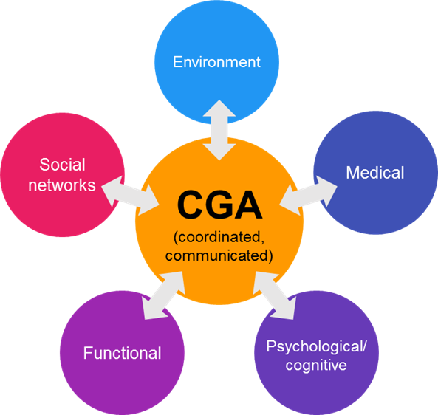
Comprehensive Geriatric Assessment
“A multidimensional, interdisciplinary diagnostic process to determine the medical, psychological, and functional capabilities of a frail older person in order to develop a coordinated and integrated plan for treatment and long-term follow-up.”

Slide 7
A bit of detail...
Multidimensional:
Not just troponin pathways for chest pain
Interdisciplinary diagnostic process:
Flattened hierarchy
Mutual respect
Constructive challenge
Coordinated and integrated plan for treatment:
Understanding of each other’s roles and expertise
Follow-up:
Sometimes bad things happen

Slide 8
A bit of detail...
Assessment
Goals
Stratified
problem list
Patient-specific management plan
Prof A Gordon, University of Nottingham

Slide 9
Comprehensive Geriatric Assessment in Urgent Care
  Identify frailty
  Broaden the assessment
  Do something different:
    Prognosticate
    Person-centred approach
    Shared decision-making

Slide 10
The 5Ms of GeriEM
Medications
Mind
Mobility
Multicomplexity
What Matters most

Slide 11
Geri EM competencies
    Atypical presentations of disease
    Trauma including falls
    Cognitive assessment
    Comprehensive assessment
    Functional assessment
    Polypharmacy
    Polymorbidity
    Transitions of care

Slide 12
Summary
Geriatric EM has emerged as a subspecialty
Comprehensive Geriatric Assessment (CGA) improves outcomes for older people with frailty and urgent care needs
  Use CGA as an organising framework
Incorporate the competencies of geriatric care
Measure, repeat, and improve

