Slide 1


Trauma

Slide 2
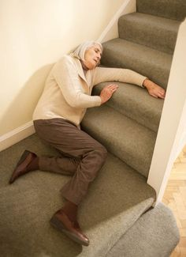
Scenario
  89 year old Mrs. B was found by her carer at the bottom of the stairs (approx. 10 steps).
  She is very confused and bleeding from a scalp wound.
  Her right leg appears shortened and rotated.
  She has a past medical history of hypertension and osteoporosis.

Slide 3
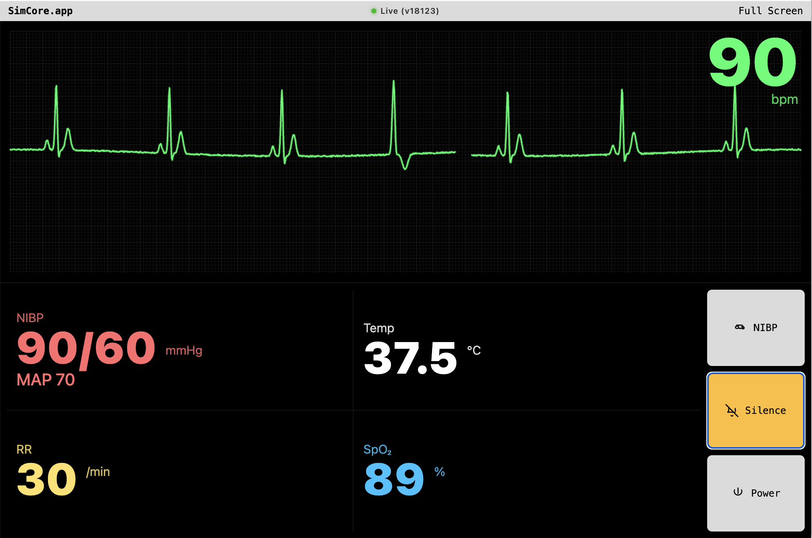
10 L/min oxygen:
SpO2 95%

Slide 4
How will you manage this person?

Slide 5




Identify trauma team leader who will assign roles – 1 nurse, 1 SHO/junior doctor at the start of scenario
Given the mechanism of injury – Silver trauma Call to be put out.
2 more roles -Anaesthetist on the way (to be assigned), can help with c-spine immobilisation and AMPLE history
Ortho registrar to come later in scenario and surgeons.

Slide 6
Primary survey
A- patent (pt. is talking but confused)
Some midline C-spine tenderness (aim for c-spine immobilisation in the most optimum position)
B- spontaneous, tachypnoeic – already on O2 (SpO2 95% on 10litres) AEBE – chest wall tenderness over right side.
C-90/60mmHg – cautious iv fluid bolus- improvement to 110/70 mm Hg (250-500ml crystalloids) Send bloods/ group & save /BM
P/A – soft non-tender (difficult exam because patient confused)
Tender over right hip / rotated/ shortened

Slide 7
D- GCS E4 V4 M5 (13/15) patient very confused
Pupils B/L 3+
E – maintain normothermia
Findings
Right scalp wound bleeding – apply pressure/bandage
Avoid log roll – ?pelvic fracture ?#NOF
Pelvic binder to be considered.
Analgesia to be given/ fascia iliaca block can be considered.

Slide 8
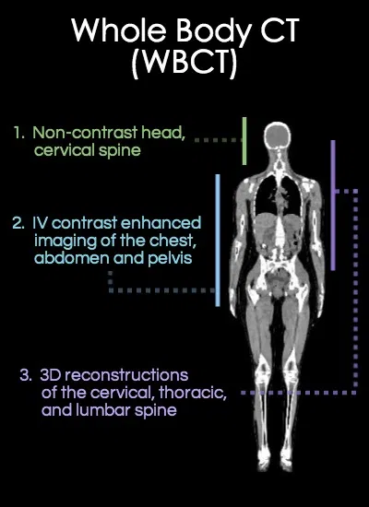
Discussion with Radiologist – Silver trauma – pan CT head to pelvis to be requested.
AMPLE h/o to be taken but patient is confused ( NOK to be informed )
Secondary survey
Head to toe exam- keep it brief – right distal radius fracture and right pre-tibial lacerations
Ortho role-player to do the secondary survey.

Slide 9





Injuries (time permitting)
CT chest - multiple rib fractures on right but no flail segment
CT head - right frontal contusion
CT c-spine - no fracture
CT abdomen - no injuries
CT pelvis – # right NOF

Slide 10
Silver survey (special focus)
The purpose of the Silver Survey is to consolidate the findings of the primary and secondary surveys as well as identifying any individual risk factors for the development of delirium.
It may not be possible to conduct such an assessment in the Emergency Department, especially if the patient is due to be transferred to theatre or critical care. However it should be completed as soon as it is safe to do so.
Handouts for Silver Survey to be given to candidates.
(PDF uploaded separately)

Slide 11

Further reading
  HECTOR manual - http://www.heftemcast.co.uk/the-hector-course-manual-foamed/
  https://geri-em.com/trauma-falls/introduction/
  Chapter on Geriatric Trauma in the ATLS Course Manual
  https://em3.org.uk/leicgem-lecture-3

