Slide 1
Syncope

Slide 2
  - Describe and classify syncope
  - Recognise the limitations of guidelines applied to older people living with frailty
  - Integrate evidence and person-centred assessment during shared decision-making

Slide 3
2018 ESC syncope guidelines
Syncope:
transient loss of consciousness
  amnesia / loss of awareness, abnormal motor control, unresponsiveness
due to cerebral hypoperfusion
Characteristically:
rapid onset
short duration
complete recovery

Slide 4
Classification
Syncope
Cardiogenic
Reflex
(neurogenic, ‘vasovagal’)
Orthostatic
hypotension
Caution! head trauma, epileptic seizure, psychogenic seizures can also cause transient loss of consciousness

Slide 5
2018 ESC syncope guidelines
“there is strong consensus that the management of unexplained falls in older people should be the same as that for unexplained syncope”

Slide 6
Risk assessment
Many scores exist, but these are not validated for older people living with frailty. Clinician judgement necessary!
Low risk:
Prodrome symptoms
Likely trigger
Recurrent identical events
Normal examination
Normal ECG
High risk:
Chest pain / palpitations
During exertion
While lying / sitting
Structural / coronary artery disease
Certain ECG abnormalities
Most older people are somewhere in between!

Slide 7
Ambulance record
Situation: 88 year old person, fall
Background: Hypertension, mild dementia.
Uses apixaban, bisoprolol, amlodipine, furosemide. Lives alone. Carer visits twice daily
Assessment:
Person cannot now recall events. Had telephoned their daughter and said they were reaching for a kitchen cupboard, felt dizzy, and fell backwards. Unable to get up.
On arrival: sitting against wall. Bruised left shoulder. Comfortable. No other injuries.
Felt unsteady when helped to stand up
Recommendation: Transferred to ED for assessment

Slide 8
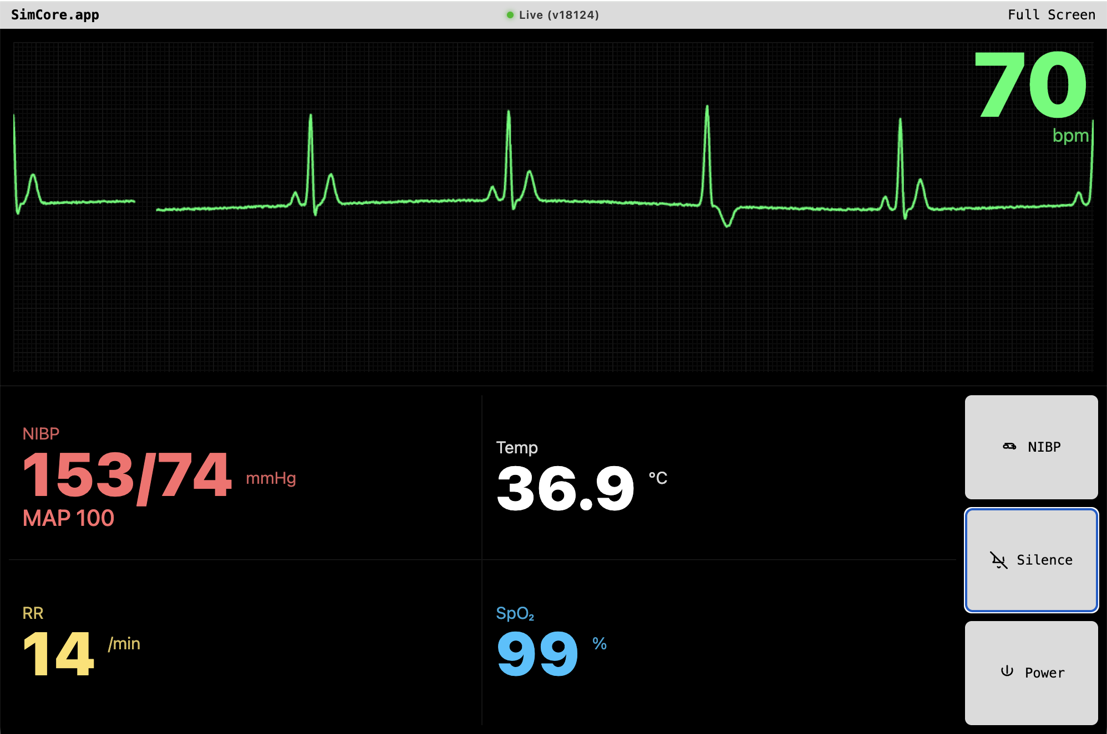
Pain: mild
BP standing: 149/73

Slide 9
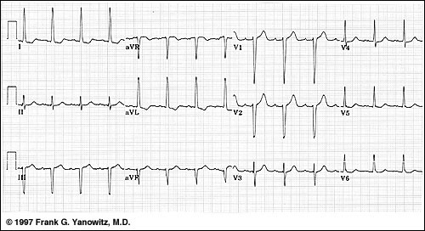

Slide 10
  Was this syncope? What is the danger of this happening again?
  What does the person want?
  What investigations or interventions are required?
  Can she go home?

