Slide 1
Sepsis
Mrs Johnson
...and her daughter

Slide 2
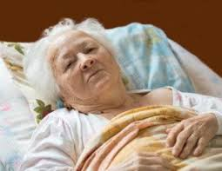
Meet Mrs Johnson…
An 80-year old woman who is brought in by her daughter
although her mother has no complaints.

Slide 3
Medical information for Mrs Johnson…
  Past Medical History:
  1998: COPD Gold 2,
  2008: Type 2 diabetes mellitus,
  2010: Anterior myocardial infarction
  Medication:
  Seretide
  Metformin 500mg
  Aspirin 100mg
  Perindopril 2mg
  Nitroglycerin
  Furosemide 20mg

Slide 4
Vital signs at triage Mrs Johnson…
  Triage (Manchester Triage System):
  O₂ saturation: 97%
  Heart rate: 75/min
  Temperature: 37.7 ᵒC
  MTS category: GREEN

Slide 5
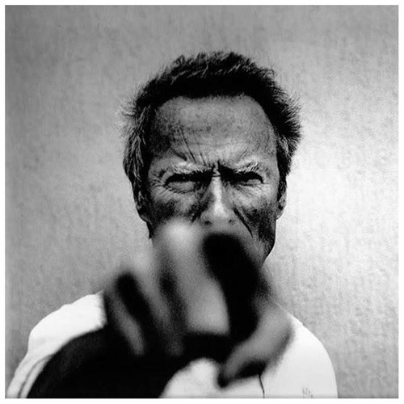
Now it’s your turn…

Slide 6

=
Unwell
Under triage

Slide 7
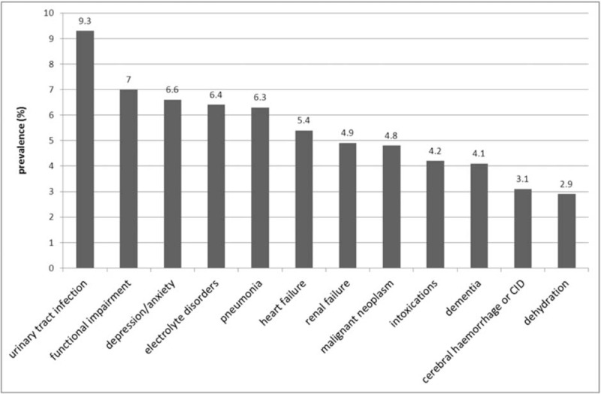
Non-specific complaints (Feeling unwell)

Slide 8
Risk stratification
Most risk stratification scores (MEWS/qSOFA/PIRO) don’t work in older patients

Slide 9




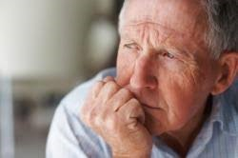
Systolic BP:
'Normal’ vital signs change with age
70-90
80-95
100 - 120
120
140

Slide 10
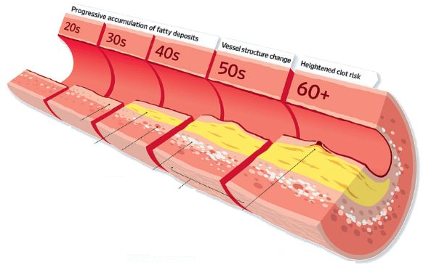
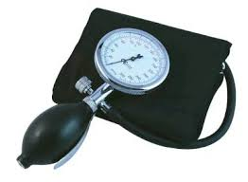
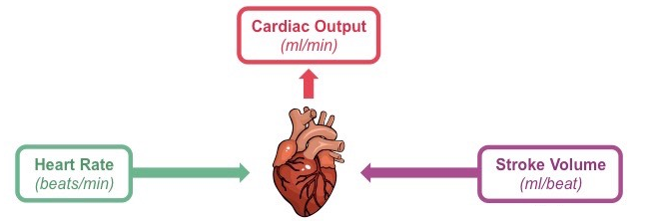
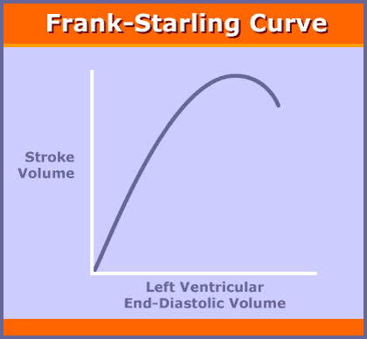
Changing (patho)physiology
After load
Contractility
Preload

Slide 11
Take home messages: Sepsis in older people
  1. You will miss it because:
  Atypical patient presentations (i.e. falls, syncope…)
  Normal vital signs are not normal
  Most used scores do not work in older people
  2. You will undertreat it because:
  Undertriage
  You are scared to administer fluids

