Slide 1
Pain

Slide 2

Edna Jones
Age: 79
Presenting complaint: lower back pain, nausea, abdominal distention

Slide 3
History
  Medical history:
  CKD2
  Controlled hypertension
  Previous stroke causing expressive dysphasia
  Osteoarthritis - knees
  Fibromyalgia
Medication:
Aspirin
Bisoprolol
Amlodipine
Simvastatin
Citalopram
Co-codamol 8/500mg
Ferrous fumarate

Slide 4
Social history
Lives alone in a 3 bedroomed flat
Stairlift
Carers twice per day for washing and medication
Can walk 2-3 metres due to knee and lower back pain
Weight 52 kg

Slide 5
How will you assess Mrs Jones’s pain?

Slide 6
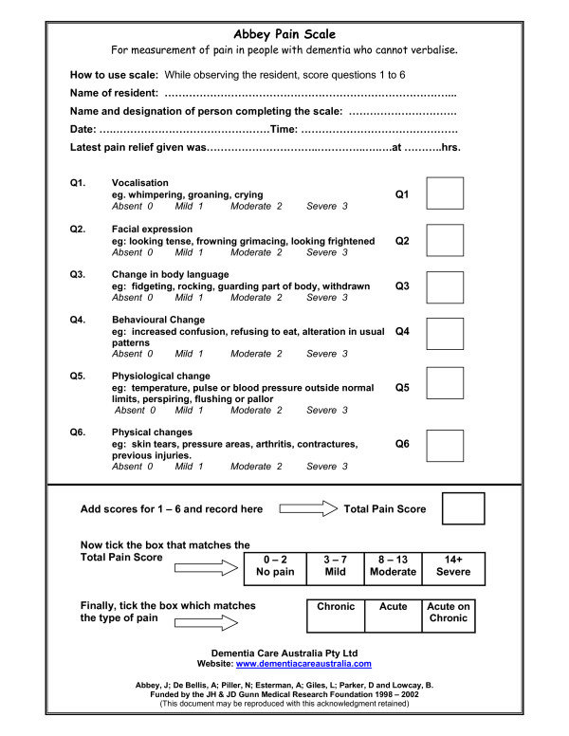
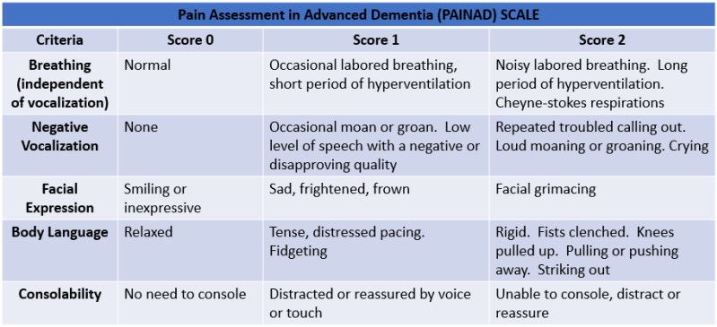
Location, chronicity and severity?

Slide 7
  What is worrying about Mrs Jones’ presentation, medication, and social history?

Slide 8
Mrs Jones has had unchanged bilateral knee pain and lower back ache for several years, following a fall three months ago she was started on oral co-codamol 8/500mg as required. Her carers changed last week, and her medicines chart show she has received 8 tablets per day.

Slide 9
Mrs Jones’ examination is mostly normal. There is a soft fullness in the left iliac fossa and some hard stool in her rectum, but her bloods are essentially normal apart from a slightly chronically raised urea and creatinine (7 and 70). An abdominal x-ray performed from triage shows an old wedge fracture of L3.
How will you manage Mrs Jones?

Slide 10
  As you plan to discharge her with appropriate analgesia, her daughter asks if she should still take the night-time special pain killer for restless legs?

Slide 11
Side effects of atypical analgesics
TCAs: urinary retention, postural hypotension, cardiac arrhythmias. 1 in 5 stop due to adverse effects
SSRI/SNRI: minimal evidence base but duloxetine has shown efficacy for neuropathic pain, especially diabetic
Anti epileptics: older medication such as carbamazepine and phenytoin have central adverse events and require blood monitoring. Newer, e.g. gabapentin have shown efficacy and fewer side effects.
Topical NSAIDs: several studies show efficacious in non-neuropathic pain.

Slide 12
Mrs Jones asks about specialist follow up for her pain, and any interventions.

Slide 13
Learning points
50% of those aged over 65 years have a painful condition
Assessing pain can be difficult (use tools e.g PAINAD, Abbey pain scale)
Side effects of medication, weight-based toxicity, red flags for pain
Use non-pharmacological options where possible
Avoid opiates where possible, and add bowel protection
Atypical analgesics and specific conditions they can be used for
Referral to chronic pain teams, physio, mindfulness and occasionally CBT/acupuncture

