Slide 1
Getting Care Right at the end of life
EOLC for older people

Slide 2
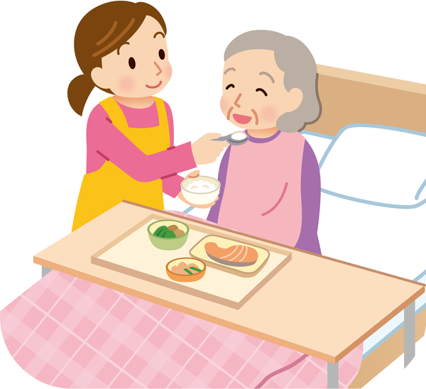
Ethel
84 y/o lady
P/C: She is noted to appear breathless and just not her usual self.
PMHx: Advanced dementia
SHx: Lives in long term care. Needs assistance with most ADLs, eats independently.

Slide 3

Ethel’s Story
  Pulse 104, BP 90/50
  SpO2 87%, RR 28
  GCS 13
  Chest clear, abdomen soft.

Slide 4
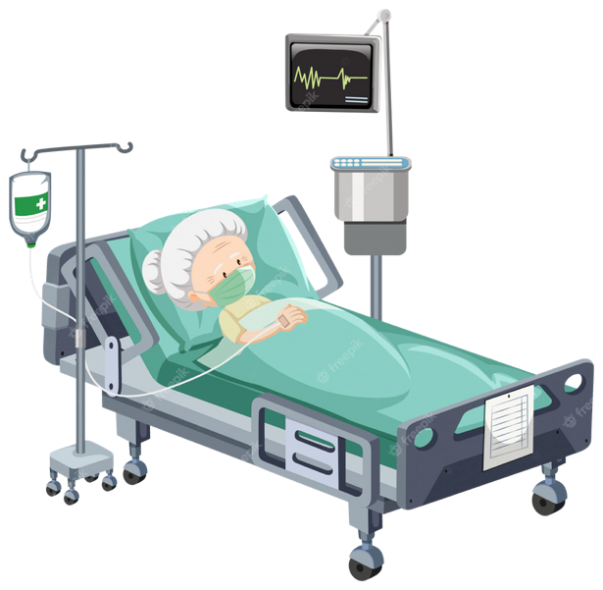
SEPSIS ?

Slide 5
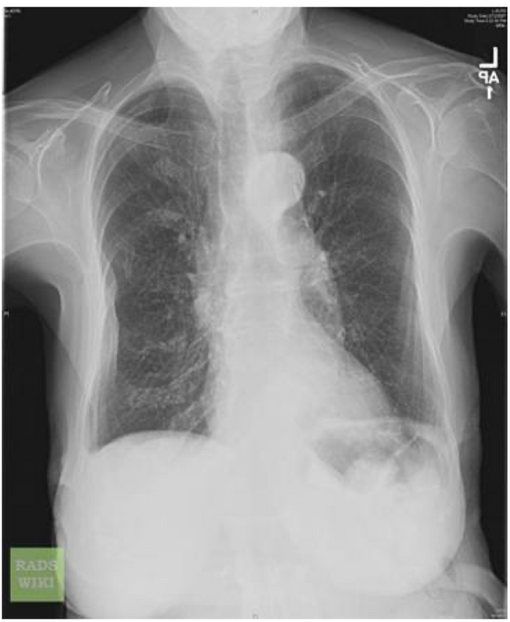
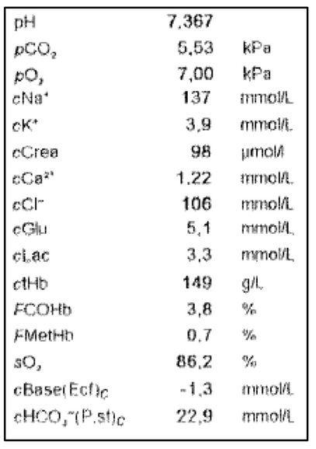

Slide 6
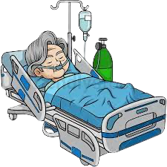
Ethel’s Story
  Pulse 100, BP (improved) 110/60
  SpO2 94%, keeping 28% O₂ mask on
  Remains drowsy, GCS 13
  Difficult to obtain info.

Slide 7
Ethel’s Story
  Deterioration over months
  DNACPR in place
  Daughter NOK
  Little additional information

Slide 8
Ethel’s Story
  Investigations show little extra information
  WCC 11.4
  CRP 24

Slide 9
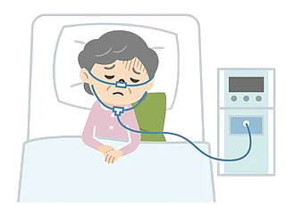

Ethel’s Story
Death Certificate
  Community Acquired Pneumonia
  Dementia

Slide 10
Questions
  Was this a good end of life experience for Ethel?
  What could have been done differently in the nursing home, by the ambulance crew, in the ED or in the frailty unit?
  Do you agree with the death certificate?
  How much of this was predictable?

Slide 11
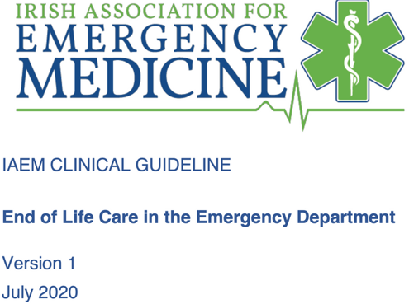
Diagnosing Dying
Diagnosing dying is a complex clinical decision and should only be made by the most senior clinician available, after all possible reversible pathology have been excluded.

Slide 12
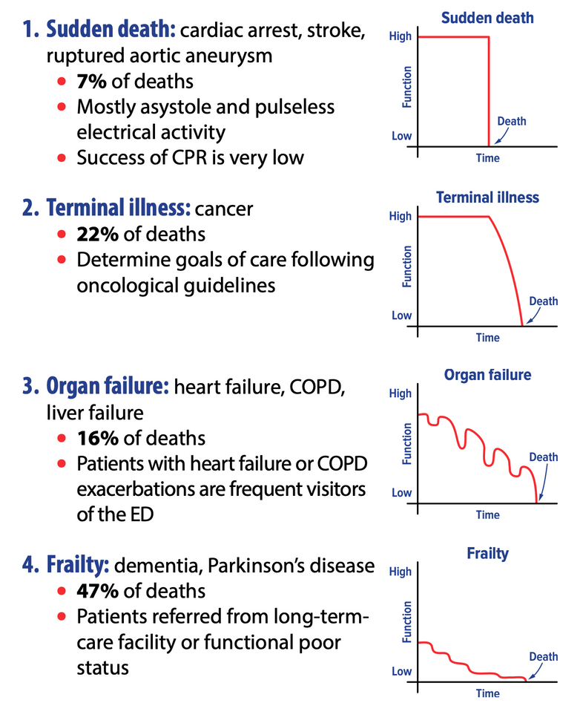

Slide 13
  Communication
  Uncertainty
  Balancing hope with realistic expectations
  Cure sometimes, treat often, care always

Slide 14
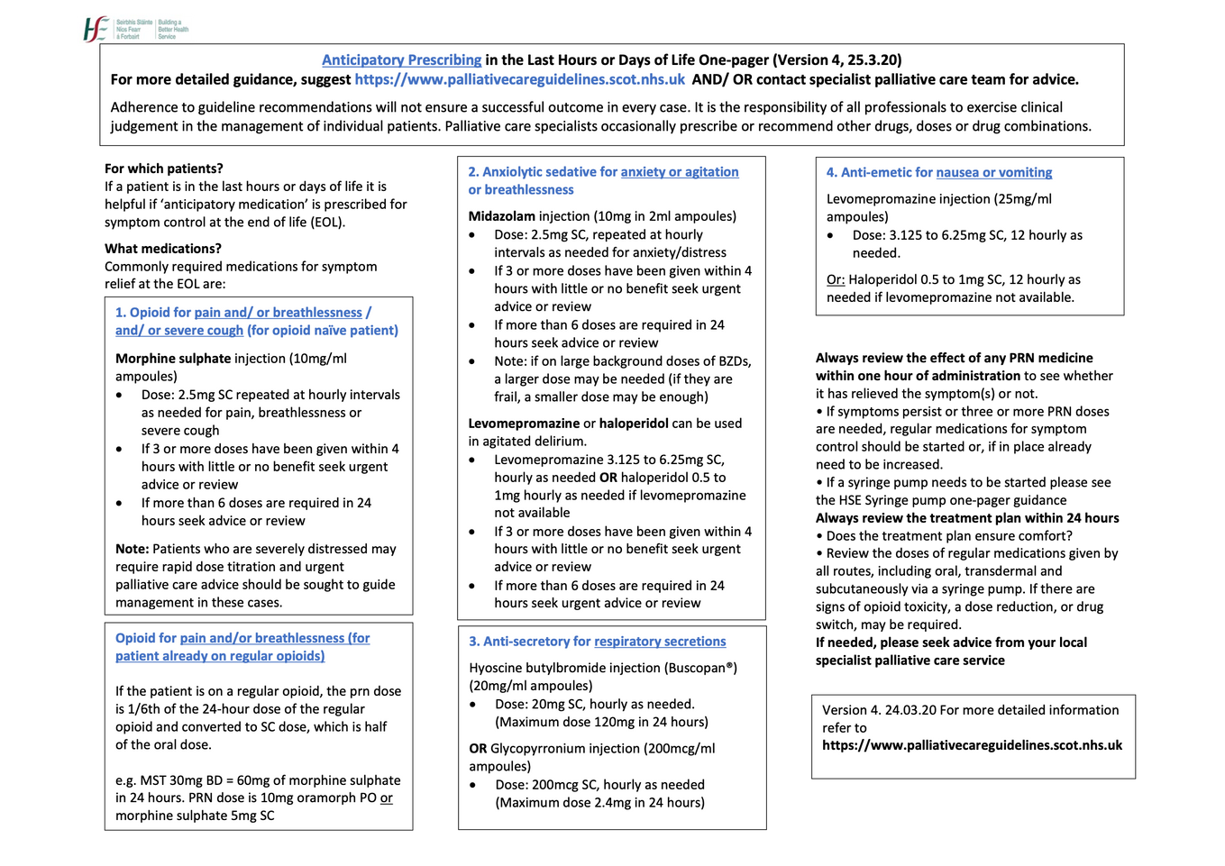
https://marymount.ie/support-hub-for-healthcare-professionals/end-of-life-covid-19-resources/

Slide 15

Resources
End of Life Care | geriEM Europe

