Slide 1
Delirium

Slide 2

Mrs Robinson
Age 86
Attends with son
Presenting complaint:
  Ambulance transfer after fall
Not cooperative
Normal vital signs
Slightly elevated temperature
Some crepitus

Slide 3
Medical history
Past medical history:
  Hearing problems
  Hypertension
  Hypercholesterolemia
  Atrial fibrillation
  Sleeping problems
Medication use
  Elanapril
  Metoprolol
  Simvastatin
  Nortrilen (antidepressant)
  Lorazepam

Slide 4
Heteroanamnesis
PREMORBID situation
  Lives alone, one son.
  Manages well with help of son and daily meal service.
CURRENT situation
  Yesterday in the afternoon, she was wearing her pyjamas
  She did not understand why son visited her and what day it was.
  She kept asking about her deceased husband.
  Son stayed the night; during night constantly walking + saw crows flying around the room.
  This morning a bit groggy + fall in the living room

Slide 5
  Does this patient have delirium?
  What symptoms do you recognize?
  What type of delirium is this?
  Why is it important to detect delirium?

Slide 6
  Do you use a screener in clinical practice to detect delirium in all ED patients?
If yes, which one?
  At what point during the ED attendance do you screen for delirium?

Slide 7
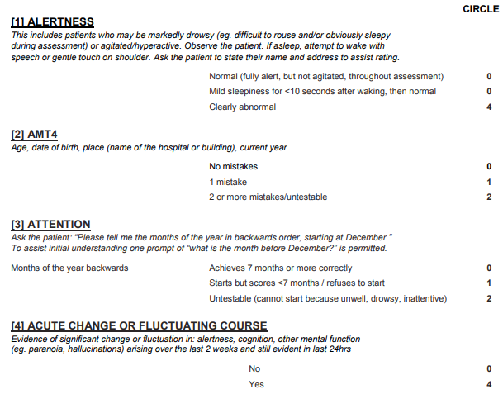




Slide 8
What diagnostics would you like to do?

Slide 9
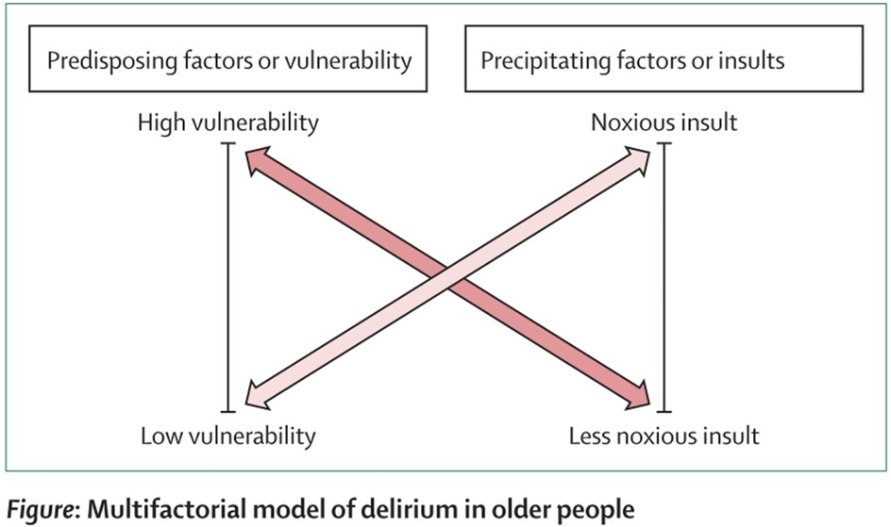
What predisposing and precipitating factors does this patient have?

Slide 10
Predisposing risk factors for delirium
Demographics | Comorbid Disease | Drugs
Advanced age | Number of comorbidities | Polypharmacy
Male | Severity of comorbidities | Psychoactive medication use
 | Visual impairment | Alcohol abuse
 | Hearing impairment | Drug abuse
 | Dementia
 | Depression
 | History of delirium
 | Cerebrovascular disease
 | Falls
 | Functional impairment

Slide 11
Precipitating causes of delirium
Systemic disease | Primary CNS disease | Drugs | Environmental
Infection/sepsis | Stroke | Polypharmacy | Prolonged ED stay
Dehydration | Meningitis | Withdrawal | Sleep deprivation
Hypoxia | Encephalitis | Drugs or alcohol use | Physical restraints
Hypercarbia | Subdural hemorrhage | Anticholinergics | Indwelling urinary catheter
Shock | Epidural hemorrhage | Sedative-hypnotics | Pain
Hypo/hyperglycemia | Intracerebral hemorrhage | Opioids | Surgery or procedures
Hypo/hyperthermia | Seizures/postictal state
Trauma
Acute myocardial infarction

Slide 12
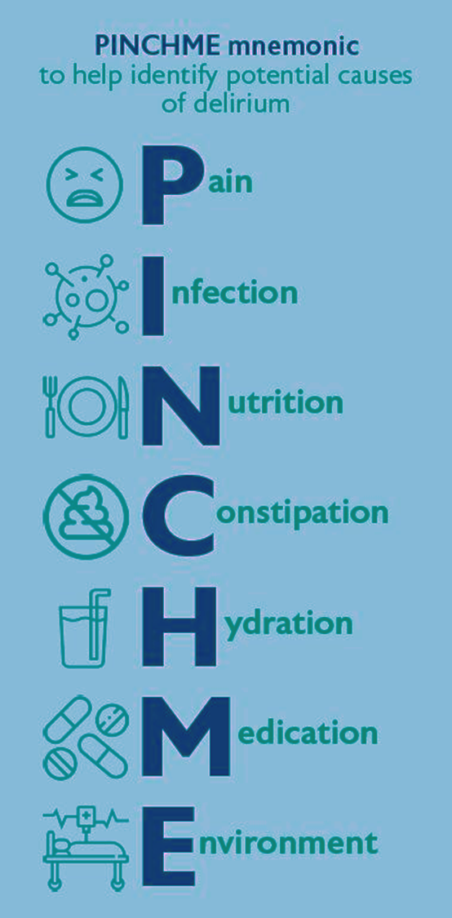

Slide 13
What pharmacological treatment would you consider?
What non-pharmacological treatment would you consider in the ED and during admission?

Slide 14
What model of care do you have in the ED?
    Do you test for cognitive impairment in the ED?
    Do you start preventive measures in the ED?
    Do you use a multidisciplinary approach?
    Is a geriatrician involved?

Slide 15
Delirium
Delirium is frequently missed in the ED
Test for delirium and cognitive impairment using 4AT
Look for predisposing and precipitating factors of delirium
Start non-pharmacological treatment as soon as possible, preferably in the ED
Start measures to prevent delirium in older patients with cognitive impairment

Slide 16

Useful Resources
https://posters.geriemeurope.eu/posters/p04/
https://www.the4at.com/
https://deliriumnetwork.org/about/delirium-research-resources/

