Slide 1
Abdominal pain

Slide 2
Mr Cleaver
76 M, sent to ED with acute abdominal pain for two hours
Sitting in garden, sudden severe lower abdominal pain radiating to flank and right groin. Intermittent. Nausea. Normal stool and urine
Tried diclofenac from GP
Background: hypertension, chronic kidney disease, diverticulosis, cataracts. Smoker
Uses metoprolol, furosemide, simvastatin, adcal, colecalciferol

Slide 3
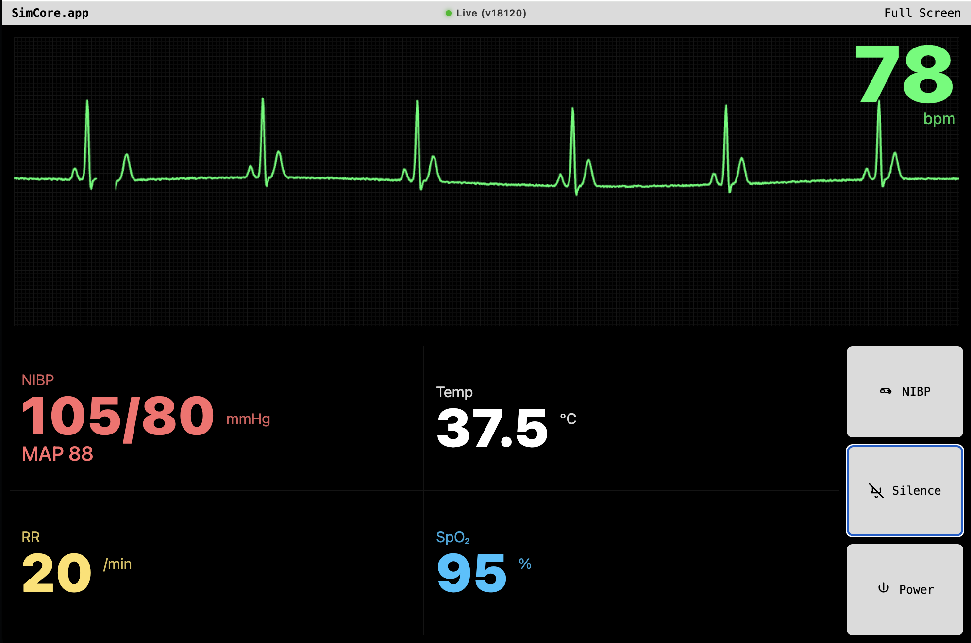
Capillary refill: 2 secs
GCS: 15
Glucose: 5.5
Hb: 8.0
Lact: 10.7
eGFR: 28

Slide 4
Differential diagnoses?
Investigations?
Interventions?

Slide 5
Diagnoses in non-traumatic abdominal pain
 |  | Absolute (n) | Relative (%)
Top 5—outpatient diagnoses (total number of cases: 35 944)
1. | R10 (abdominal and pelvic pain) | 10 577 | 29.4%
2. | K29 (gastritis and duodenitis) | 3257 | 9.1%
3. | A09 (other gastroenteritis and colitis of infectious and unspecified origin) | 2740 | 7.6%
4. | N30 (cystitis) | 1280 | 3.6%
5. | N39 (other diseases of urinary system) | 942 | 2.6%
Top 5—inpatient diagnoses (total number of cases: 12 725)
1. | K35 (acute appendicitis) | 861 | 6.8%
2. | K85 (acute pancreatitis) | 572 | 4.5%
3. | K56 (paralytic ileus and intestinal obstruction without hernia) | 559 | 4.4%
4. | K80 (cholelithiasis) | 513 | 4.0%
5. | N13 (obstructive and reflux uropathy) | 509 | 4.0%
Top 5—causes of death (total number of cases: 421)
1. | A41 (other sepsis) | 60 | 14.3%
2. | C25 (malignant neoplasm of pancreas) | 21 | 5.0%
3. | K56 (paralytic ileus and intestinal obstruction without hernia) | 17 | 4.0%
4. | C22 (malignant neoplasm of liver and intrahepatic bile ducts) | 17 | 4.0%
5. | K72 (hepatic failure) | 14 | 3.3%
Table 2. Most frequent outpatient and inpatient diagnoses and most frequent causes of death of 49 090 patients with NTAP*.
* 340 of the originally 49 430 patients with non-traumatic abdominal pain (NTAP) were not included in the analysis because of the additional note “exclusion of” or “status post.”
Helbig L et al. DtschÄBlatt. 2023 Sep 15;120(37):613–614. doi: 10.3238/arztebl.m2023.0163

Slide 6
What does treatment in the emergency department look like?

Slide 7
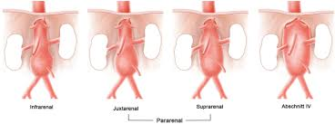
Aortic Aneurysm

Slide 8
At-risk population
Older adults
Arterial hypertension

Slide 9
Abdominal aortic aneurysm
Up to 10% of all men ≥65 years
Age is the greatest risk factor. Other risk factors:
  Male sex
  Smoking
  Family history
  Coronary artery disease, hypercholesterolemia, atherosclerosis, arterial hypertension
Typical presentation: abdominal pain, hypotension, pulsatile mass*,
  But: no hypotension in 65% of cases
  No palpable mass in 25% of cases
Caution: microscopic haematuria can occur, risk of misdiagnosis as ureterolithiasis
Ultrasound is the first-choice imaging modality, sensitivity 95%, specificity 100%. CT has a sensitivity and specificity of approximately 100%.

Slide 10
The most common misdiagnosis of ruptured AAA is renal colic
Rule: new-onset kidney stones after age 50?
= image the aorta before discharge
Missed AAA = 90% mortality

Slide 11
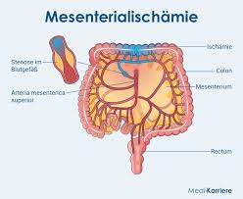
Mesenteric ischemia

Slide 12
At-risk population
Older adults
Atherosclerosis
Atrial fibrillation
No anticoagulation

Slide 13
Extra-abdominal causes of abdominal pain
Cardiac | Myocardial infarction, pericarditis, heart failure
Pulmonary | Lower lobe pneumonia, pneumothorax, pulmonary embolism
Metabolic | Diabetic ketoacidosis, adrenal insufficiency, hypercalcemia, uremia
Infectious | Herpes zoster, cellulitis, urinary tract infections
Genitourinary | Prostatitis, neurogenic bladder, uterine prolapse
Medication | Narcotic withdrawal, iron overdose, antibiotics
Hematologic | Acute leukaemia, rectus sheath hematoma (anticoagulated patients)

