Slide 1


Summary and close

Slide 2
Frailty
Abdominal pain | Delirium
End of life care | Sepsis
Pain | Polypharmacy
Syncope | Trauma

Slide 3
What is your take home point?
What will you do in your ED?

Slide 4
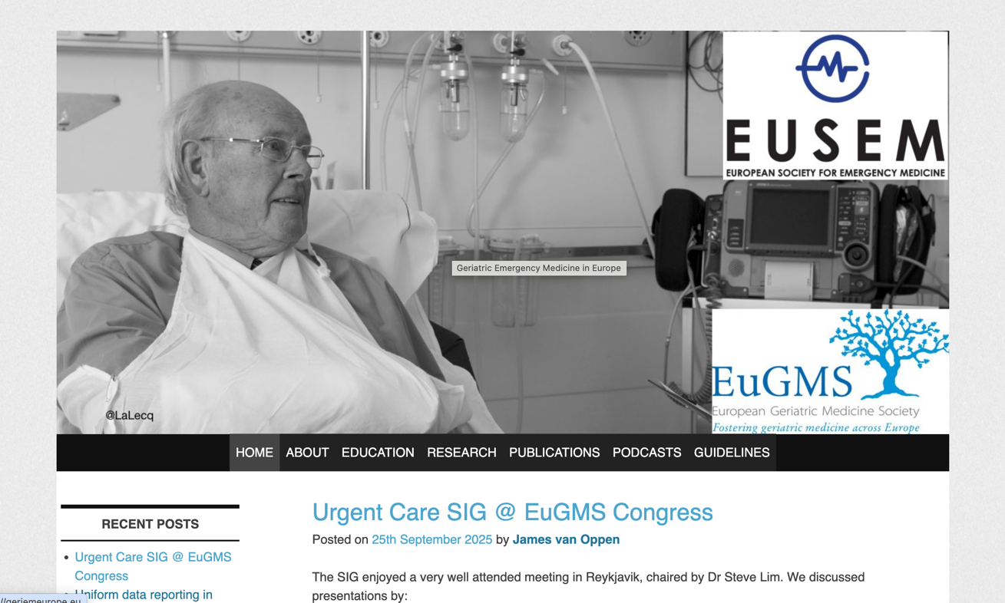
www.geriemeurope.eu

Slide 5
GeriEM activities at EUSEM 2026
Day | Time | Activity | Topic
25 September | 10:00-1130 | Symposium | What’s new in GeriEM?
25 September | 1330-1400 | Podium | Meet the GeriEM section
25 September | 1345-1515 | Symposium | Papers that changed my practice
25 September | 1500-1600 | Meeting | GeriEM section meeting
25 September | 1545-1715 | Symposium | Systems thinking in the emergency dept
26 September | 0800-0900 | Keynote | Start the day with geriatrics
26 September | 0930-1100 | Posters | Geriatrics Emergency Nursing Research
26 September | 1100-1245 | Posters | Geriatrics

