Slide 1
How to make your ED geri-friendly?

Slide 2







How to make your ED “Geri friendly”?
Notes:
SB 2012->2021
ACEP 2014 -> 2018
BGS FDF 2023
What's new in GeriEM?
Friday, 25 Sep 2026
11:00 - 12:30

Slide 3
Why do we need ED care models for older adults?
PATIENT PROFILE = MULTIPLE PROBLEMS
Interacting comorbidities
Polypharmacy
Functional and cognitive limitations
Atypical presentations
INCREASED RISK for ADVERSE EVENTS during/after ED stay
Incorrect/incomplete diagnosis
Inappropriate treatment
Mortality
Functional decline
Unnecessary admission
Unplanned readmission
…
Notes:
Older adults should be considered a special population in whom the traditional fast-paced, complaint oriented approach does not work; these patients need patient-centred approach

Slide 4
Why do we need ED care models for older adults?
OLDER ADULTS CAN UNBALANCE THE ‘FIT’ OF THE 3 INTERDEPENDENT MAIN COMPONENTS IN ED LOGISTICS
INPUT
THROUGHPUT
OUTPUT

Slide 5

Evidence of ED care models for older adults?
COMPREHENSIVE GERIATRIC ASSESSMENT (CGA)
  “a multidimensional, interdisciplinary diagnostic process focusing on determining a vulnerable older person’s medical, functional, cognitive and social capabilities in order to develop a coordinated and integrated plan for treatment and long term follow up”
  + Evidence-based concept in acute geriatric units (Ellis et al., 2017)
  ↑ P(living at home after 3-12 months) (RR: 1.06; 95% CI: 1.01-1.10)
  - Inconsistent effects in emergency medicine

Slide 6
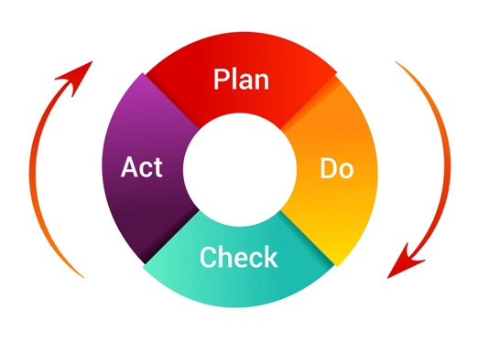
ED care models for older adults
HOW TO DEVELOP A CARE MODEL FOR OLDER ADULTS IN YOUR ED?
  !! CONTEXT ANALYSIS !!
  What are the needs of your patients?
  How can you answer these needs?

Slide 7






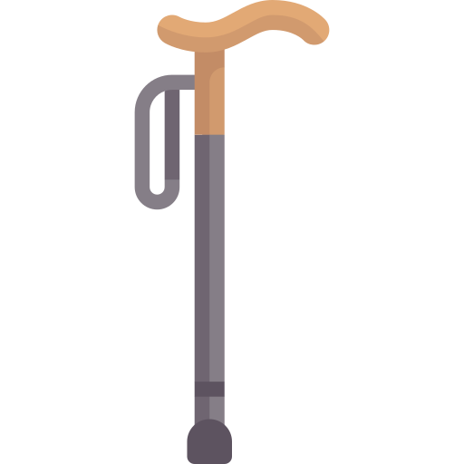
ED care models for older adults
HOW TO DEVELOP SUSTAINABLE CAPACITY FOR GERIATRIC EMERGENCY CARE IN YOUR ED?
  SPACE
  STAFF
  SYSTEMS
  STUFF

Slide 8
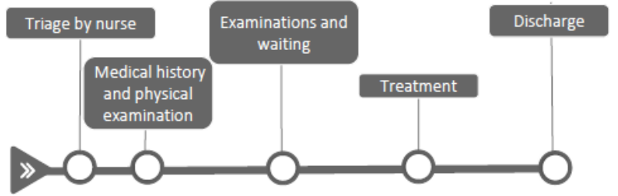
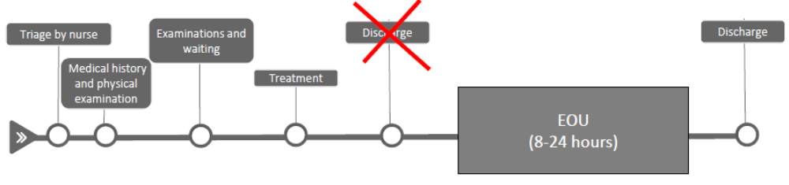
ED care models for older adults - SPACE
EDs exclusively for older adults?
Geriatric care models integrated in the ‘regular ED’
Conventional ED
ED with geriatric-focused observation beds
Notes:
4h rules; Short envisaged length of stay where miniCGA happens; of course low threshold for admission. Therefore, observation

Slide 9




ED care models for older adults - SPACE
Small changes for immediate impact:
De-clutter
Offer cues for orientation to time and place
Transform corridors into pleasant spaces for walking about safely
Ensure toilet seats and grab-rails are in contrasting colours

Slide 10
ED care models for older adults - SPACE
More ambitious changes:
Non-slip, matt flooring
A wheelchair accessible toilet / raised toilet seats
Efforts for noise reduction (e.g. silent alarms, closed rooms)
Natural light / Night-time light or dimmable lighting
Opportunity for one visitor and the patient to sit beside the bed

Slide 11

ED care models for older adults - STAFF
INTERDISCIPLINARY COLLABORATION is the key for success!
Which competencies are covered by your team?
What are referral possibilities?
What is the intervention reach?
Integrate geriatric care principles in training curricula of ED caregivers
Emergency physician
Geriatrician
Internal medicine consultant
Advanced nurse practitioner
Nurse case manager
Nutritionists
Psychiatrists
Emergency nurses
Mental health liaison nurse
Social worker
Physiotherapist
Speech & hearing specialist
Occupational therapist
Pharmacist
Physician assistants

Slide 12

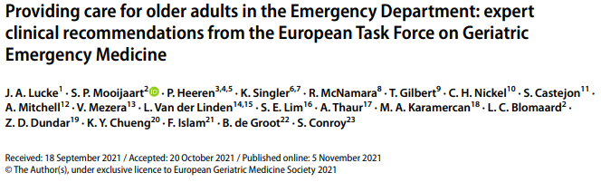
ED care models for older adults - SYSTEMS
“Set of principles or procedures according to which something is done”

Slide 13
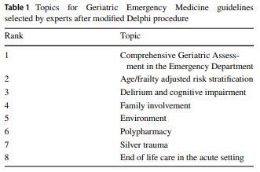
ED care models for older adults - SYSTEMS

Slide 14
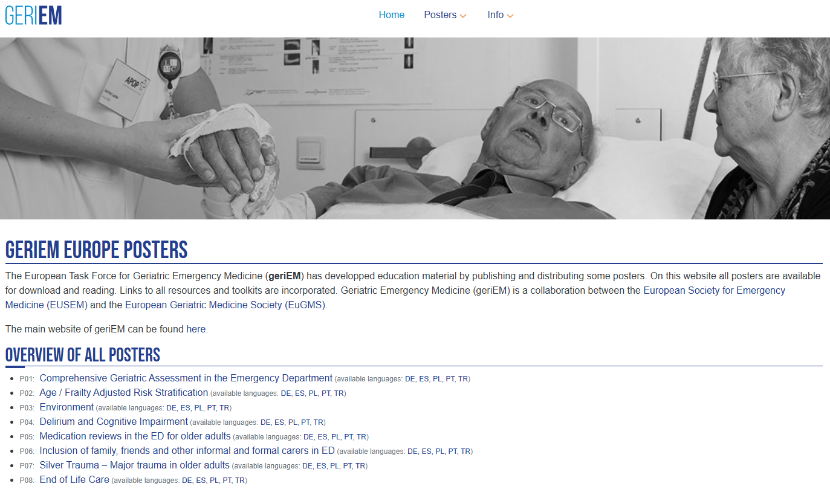
https://posters.geriemeurope.eu/
Notes:
Update!

Slide 15
ED care models for older adults - SYSTEMS
#1. Comprehensive geriatric assessment in the ED
Start with key concepts = 5Ms of geriatrics
  Mind
  Mobility
  Medications
  Multi-complexity
  Matters most
  (Tinetti, 2017)
https://geriemeurope.eu/

Slide 16
ED care models for older adults - SYSTEMS
  Time and resource consuming → feasibility in emergency medicine?
  YES, but NOT FOR ALL patients in most EDs
  Challenge = identify who benefits (most) from CGA in the ED?
Comprehensive geriatric assessment in the ED
FIRST IMPRESSION
SCREENING

Slide 17
ED care models for older adults - SYSTEMS
Geriatric screening in the ED
Identification of senior at risk (ISAR)
ITEM | Yes | No
1. Needs assistance (premorbid) | 1 | 0
2. Increased assistance | 1 | 0
3. Hospitalised past 6 months | 1 | 0
4. Visual impairment | 1 | 0
5. Memory impairment | 1 | 0
6. Polypharmacy: > 3 medications | 1 | 0
TOTAL SCORE | /6
Flemish version of Triage Risk Screening Tool (fTRST)
ITEM | Yes | No
1. Presence of cognitive impairment (disorientation, diagnosis of dementia, or delirium) | 2 | 0
2. Lives alone or no caregiver available, willing, or able | 1 | 0
3. Difficulty with walking or transfers or fall(s) in the past 6 months | 1 | 0
4. Hospitalized in the last 3 months | 1 | 0
5. Polypharmacy: ≥ 5 medications | 1 | 0
TOTAL SCORE | /6

Slide 18
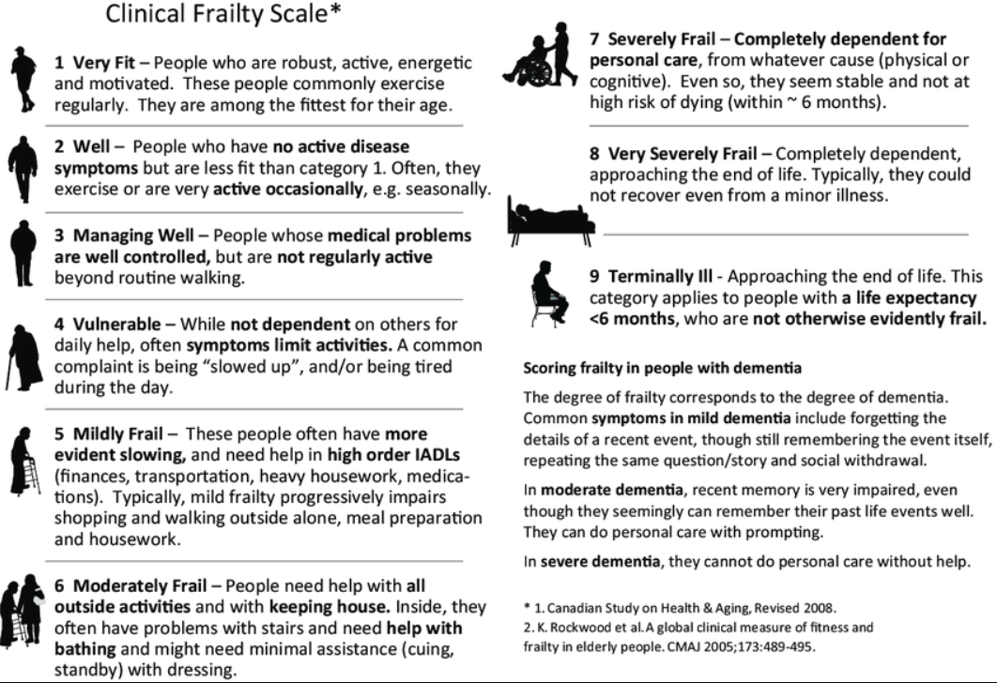
ED care models for older adults - SYSTEMS
Geriatric screening in the ED: we recommend Clinical Frailty Scale

Slide 19
ED care models for older adults - SYSTEMS
Geriatric screening in the ED: we recommend Clinical Frailty Scale
+++ UNIFORM LANGUAGE
+++ Validation studies
No strict guidelines on how to obtain the score?
Interrater reliability?
Mobility?
ADLs?
<6 months to live?
Kappa variation (0,21-0,64)
Jarman et al, 2021; Schrier et al, 2021
Slide courtesy of dr. A. Mitchell

Slide 20
EXAMPLE: Frailty screening in the ED
Experience with the idea of training the team out of low screening adherence?
  Training does not work if the system:
  - does not allow time
  - does not have dedicated professionals available
  - does not allow for any impact on patient management
  So: individual competence + team competence
  + organisational capability
  + system integration
Notes:
Experience with frailty screening in the ED?
Experience with the idea of training the team out of low screening adherence?

Slide 21
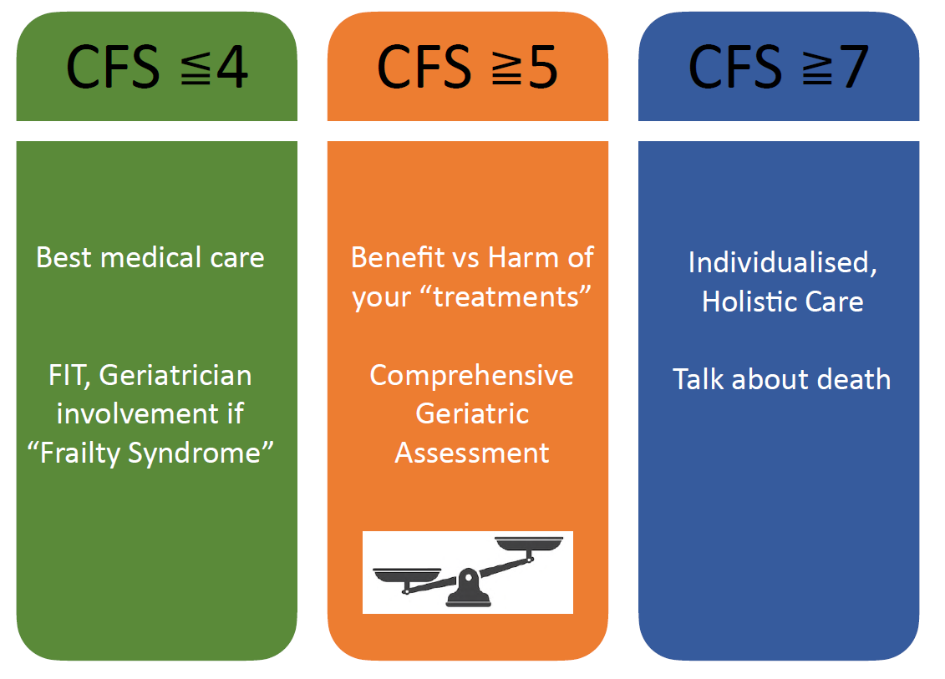
ED care models for older adults - SYSTEMS
How can patients benefit from Clinical Frailty Scale use in the ED?
Slide courtesy of dr. A. Mitchell

Slide 22
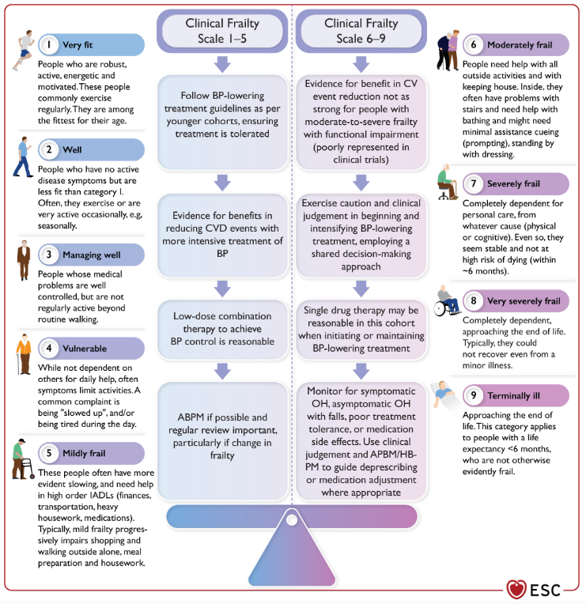
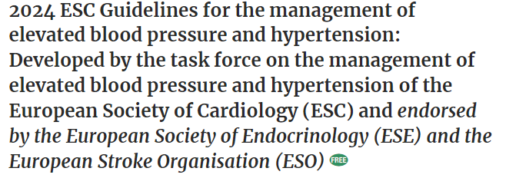
ED care models for older adults - SYSTEMS

Slide 23
ED care models for older adults - STUFF
Ensure older patients have easy access to:
Mobility aids
Nutrition and hydration
Sensory aids
Continence aids

Slide 24
ED care models for older adults
HOW TO DEVELOP SUSTAINABLE CAPACITY FOR GERIATRIC EMERGENCY CARE IN YOUR ED?
  SPACE
  STAFF
  SYSTEMS
  STUFF

Slide 25

The ED is not an ‘isle’!
Towards senior-friendly health systems
Continuity of care
Transmural data transfers are crucial

Slide 26
Initiatives optimising ED INPUT of older adults
Preventing unnecessary admissions
Outreach initiatives (e.g. EDITH – Emergency Departement In The Home)
Preventing unnecessary readmissions
Casemanager in the community
Telephone follow-up after discharge

Slide 27
IN SUMMARY
Geriatric emergency care models are necessary to guarantee quality of care for a large majority of patients in the ED
There is no ‘one-size-fit-all model’, but everything you do requires space, staff, systems and stuff
Start with key concepts = 5Ms of geriatrics
  Mind, Mobility, Medications, Multi-complexity, Matters most
Geriatric emergency care should be on the agenda of individual EDs, hospital boards, training curricula, professional organisations and policy!

Slide 28
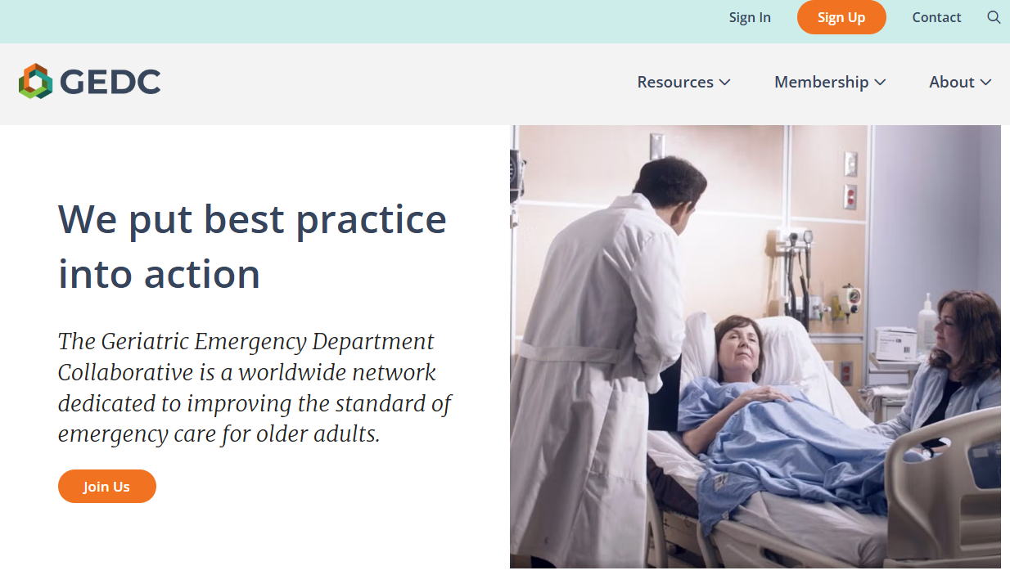
Useful Resources
https://posters.geriemeurope.eu/
https://www.healthinaging.org/tools-and-tips/tip-sheet-5ms-geriatrics
https://www.bgs.org.uk/resources/silver-book-ii-holistic-assessment-of-older-people
https://www.acep.org/by-medical-focus/geriatrics/geriatric-emergency-department-guidelines/
https://www.acep.org/geda/
https://gedcollaborative.com/

